Slide 1
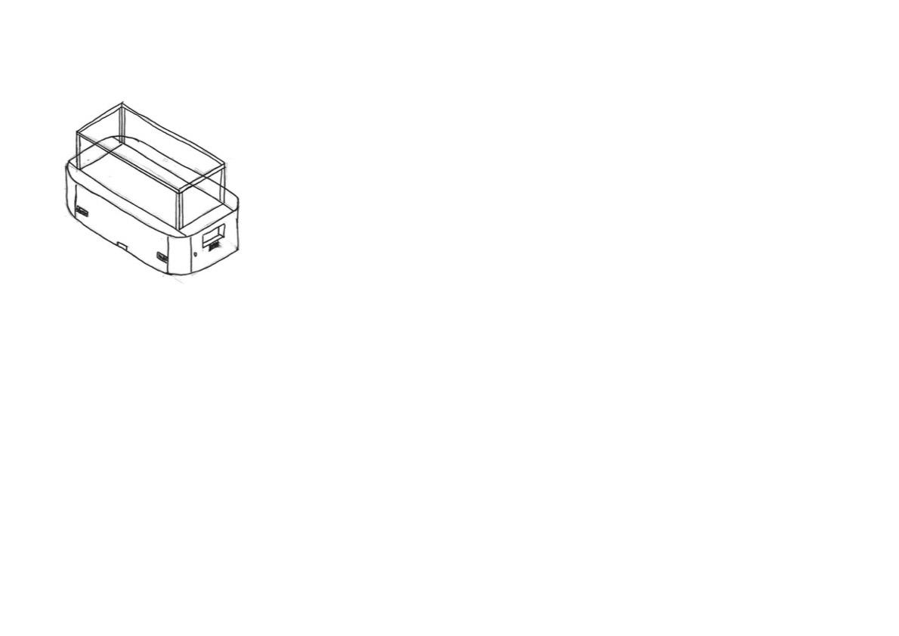
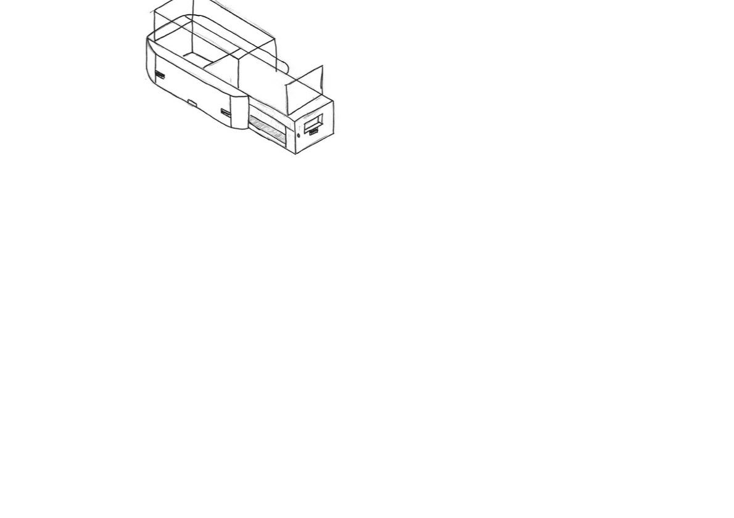
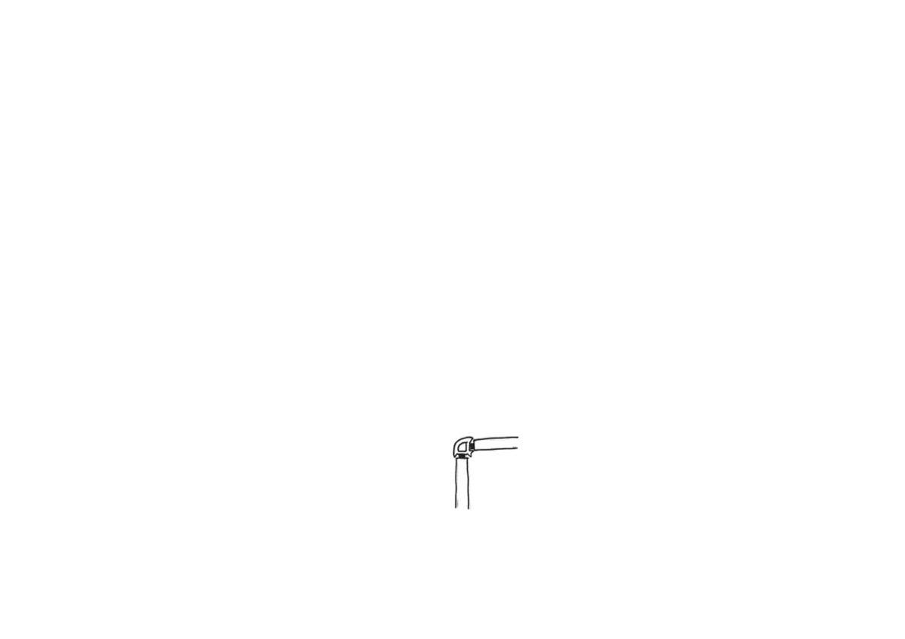


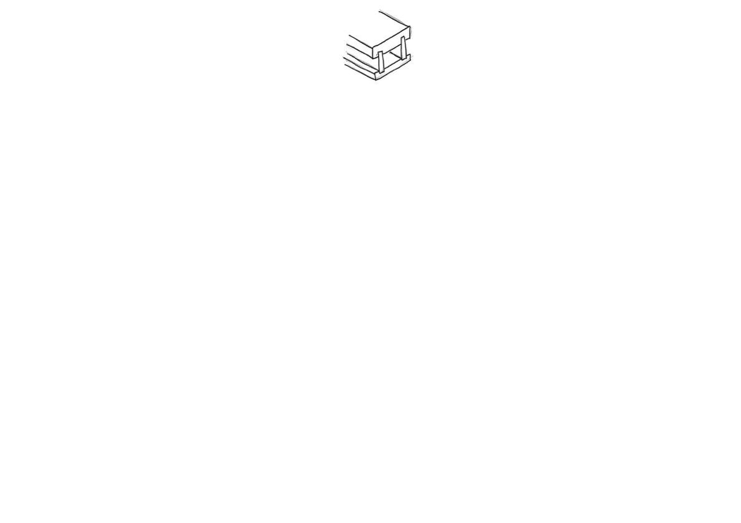
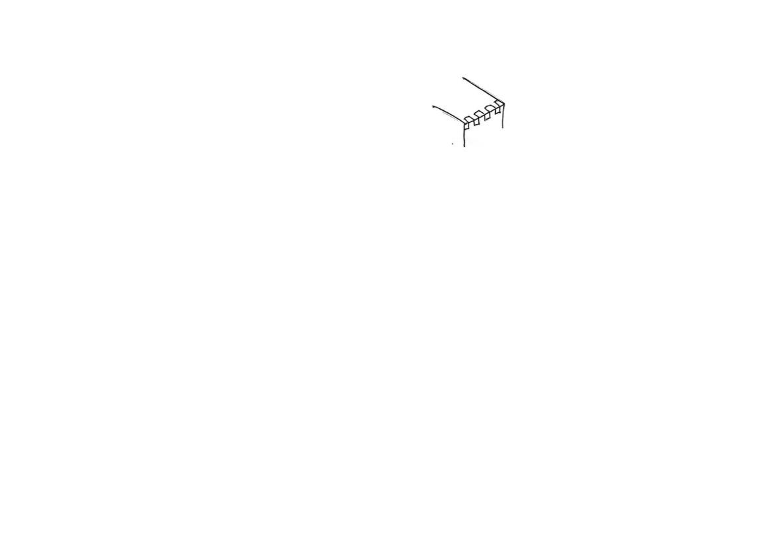
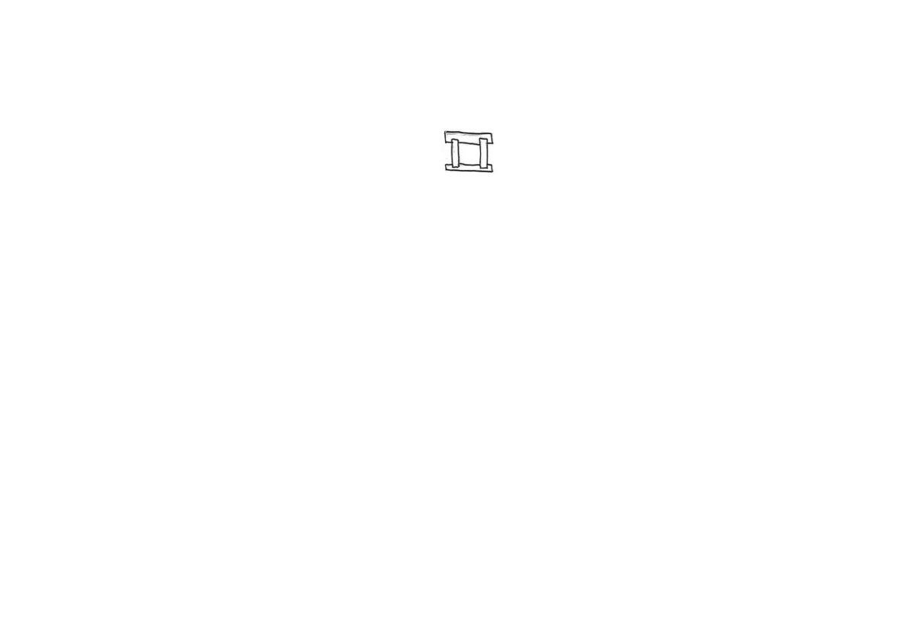
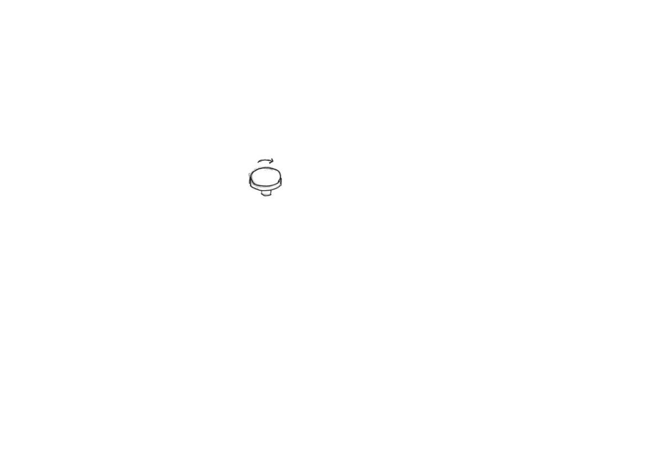

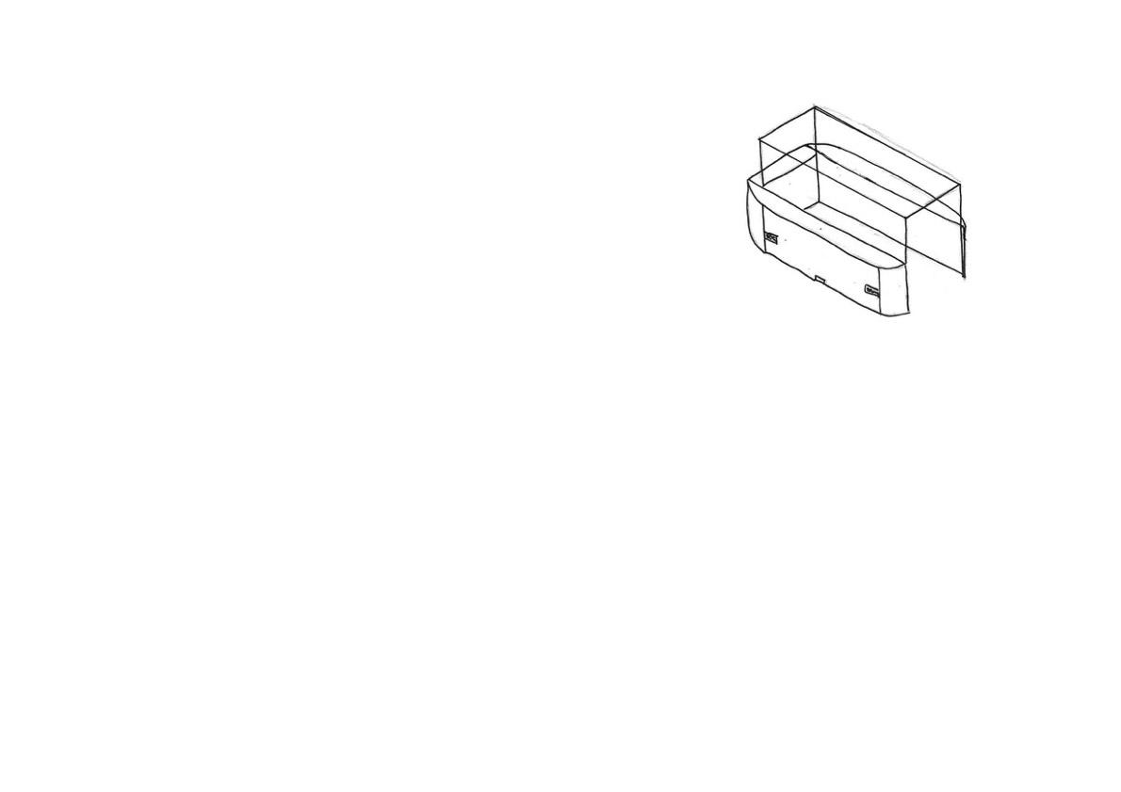
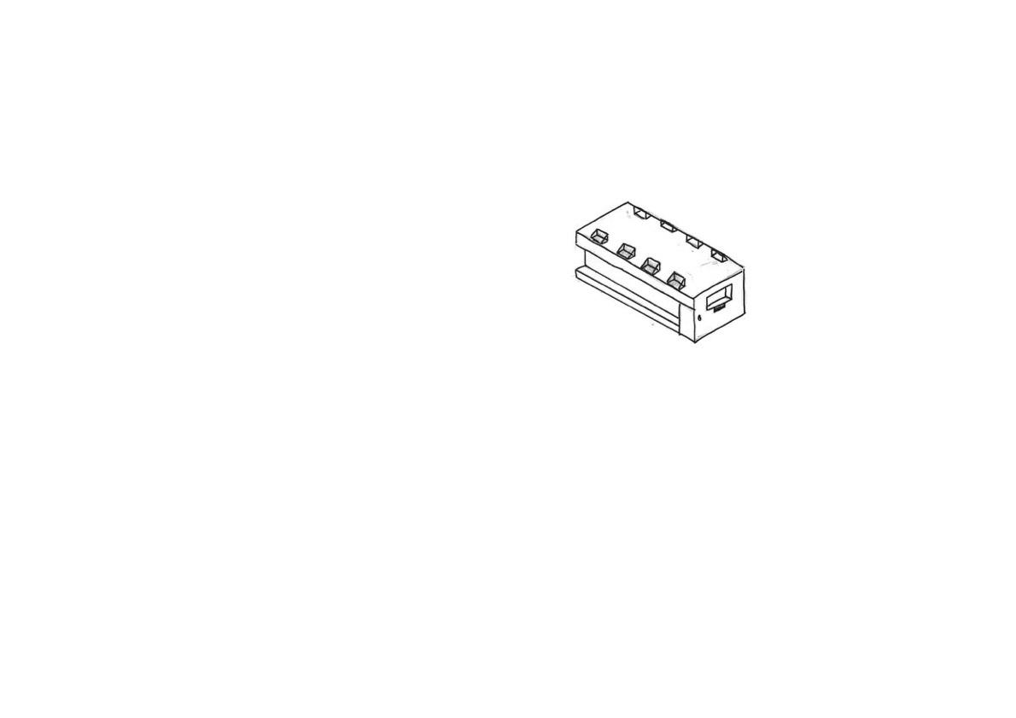
The smooth corners would be made from steam bending and then sanded down to give it a nice finish.
This is the button panel, it will not only contain the buttons but also the Arduino chipboard, to control the lights on or off via communicating to the RTC attached next to it and the motion sensors, to turn the lights and spinners off if no one is around, as requested by the design specification to reduce energy consumption.
The button panel will contain a potentiometer knob to control speed of motor. And ON/OFF switch to control whether lights are on or off.
An option for this design is that the glass panes can be joint by Glass-to-Glass steel partitioning joint
Design 1
Parts of the controller would be 3D printed. In the inside would consist of a circuit board that links to the motion sensors. An RTC would also be in here to know what time it is, and whether to turn the lights on or off
LSH, RSH, Front and Back contains 6 PIR motion sensors in total to reduce power usage.
This cabinet will be powered by mains electricity. Connected via an extension cable, and then the AC current is converted to safe 5V DC via a power adapter
Display mechanism contains a door lock to prevent theft, to provide a secure display environment for the artifact as mentioned in specification.
The wood section would be made of rubberwood to provide its integrity and joint by finger joints on its corner section. Depending on its complexity, mitre joints could even be used. And the wood section needs to be painted black as per requested by the specification.
This design consists of a drawer mechanism to access it’s inside, so it would be easier for the user to arrange the product he/she wants to put on display.
The part that slides open and closes would needs to be joint via strong housing joints. PVA glue will be used as the adhesive.
The spinner would be powered by DC electricity. A low speed high torque DC motor will be responsible for the spinning, as DC motors are save and don’t pose a risk of electrocution.
An option for this design is that the glass or acrylic panes can be joint by Silicon glue or UV glue.
The rubberwood will be covered by black veneer or black paint for aesthetic purposes. Clearcoat spray paint could be applied afterwards too.
The display side contains 8x LED lights connected to a microcontroller, ie Arduino chipboard which would be close to he button panel, which will control whether the lights are on or off.
The flat bit of the display spinner can be laser cutted with an SVG file, laser cutted acrylic have a smooth surface, and the colour could be black, giving it a minimalistic modern feel.
The display spinner’s motor flange can be 3d printed, which will then lock tightly onto the motor’s axle, allowing the spinner to spin. The flange will then be glued onto the display spinner as shown here.
Bottom side consists of railing for the drawer mechanism to slide open and close.
Notes:
Draw details on glass joints.

Slide 2
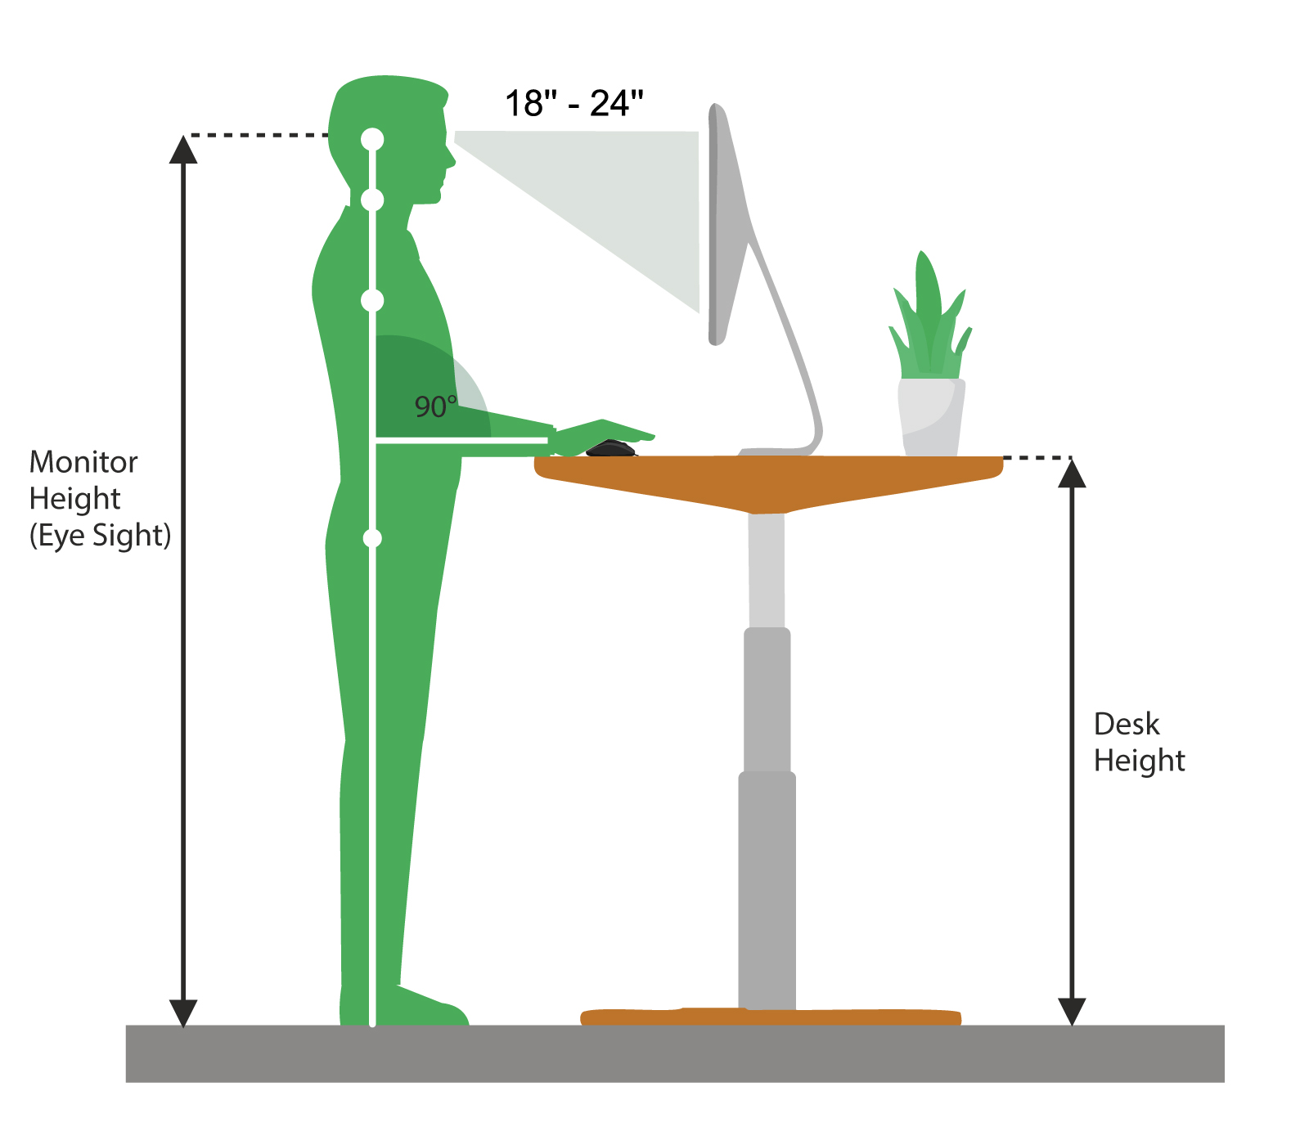
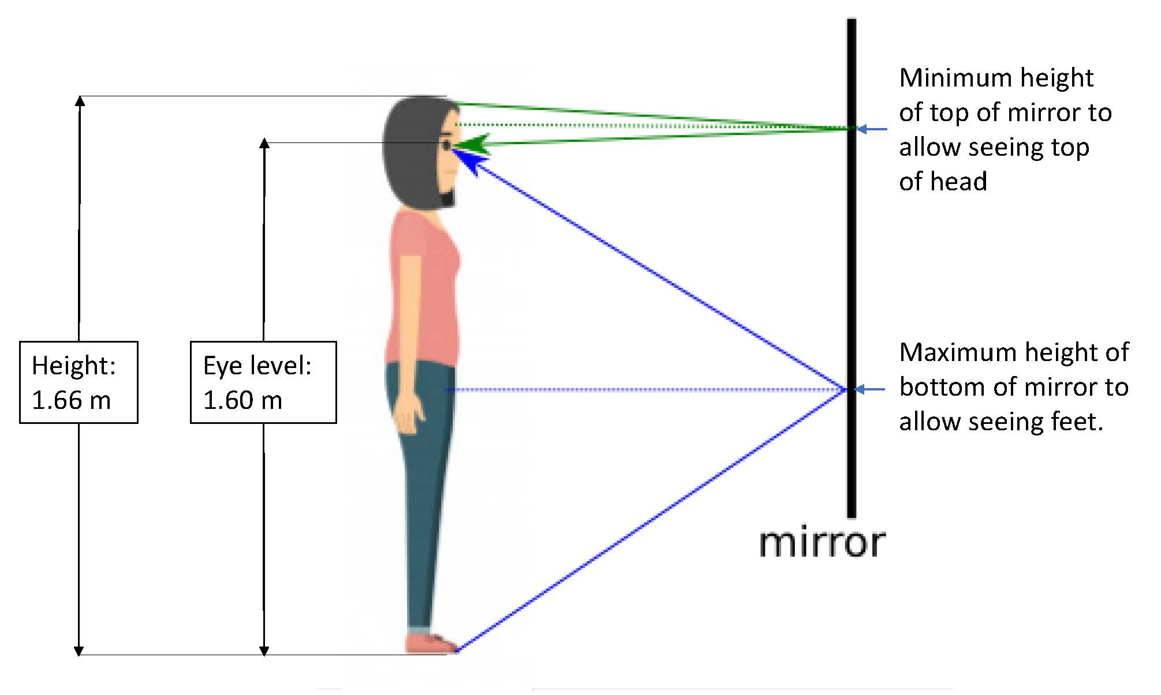
Design 1 – Development
120 cm
145 cm
500 cm
145 cm
250 cm
Since the displaying artifact needs to be at a height of 145 cm from ground, from here using the scales of this sketch, I have worked out what the dimensions of this design would approximately be.
Which, from the estimation above, the case will likely have a dimension of 5m X 2.5m X 2.65m.
For the height of this design, based on my research, which shows that eye level:height ratio is 1.04:1. Which if this display case were to be designed for world mean height of 167 cm, with an eye level of 160 cm. Further since humans tends to view things best from an angle between head tilt of 18-24 degree. Assuming that the person is standing 1 feet away, the displaying artifact needs to be at a height of 146 cm - 151 cm. Thus, in this design phase, I will assume that the height of the artifact displaying needs to be 145 cm from ground, from here I will use my drawing to estimate the dimensions of this design.
Glass-to-glass steel partitioning joint, or UV glue, or acrylic will be used to join the acrylic/glass panes together.
Wood section will incorporate mitre joints.
Overall, from the approximation drawings on this page’s top right, this means that the 5 respective pieces of glass/acrylic panes used will have a dimension of (assuming that the glass panes are 10 cm away from each respective edge):
480 cm X 120 cm (2x middle piece)
230 cm X 120 cm (2x middle piece)
480 cm X 230 cm (1x top piece)
From this information, I will determine whether is glass or acrylic suitable to be used for this design.
Each of these round, curved corner will be utilising steam bending.
Notes:
Draw details on glass joints.

Slide 3
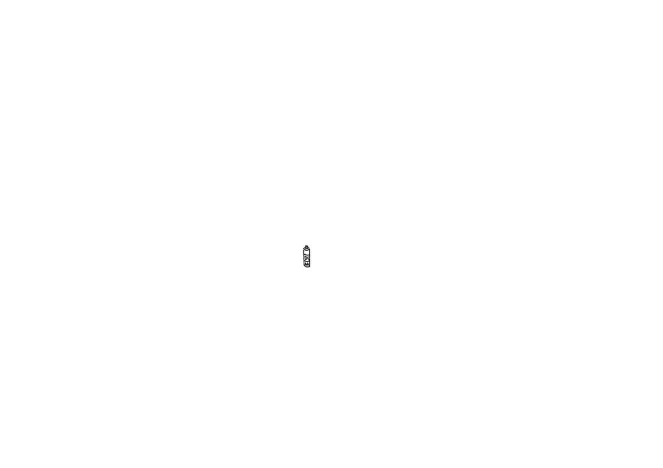
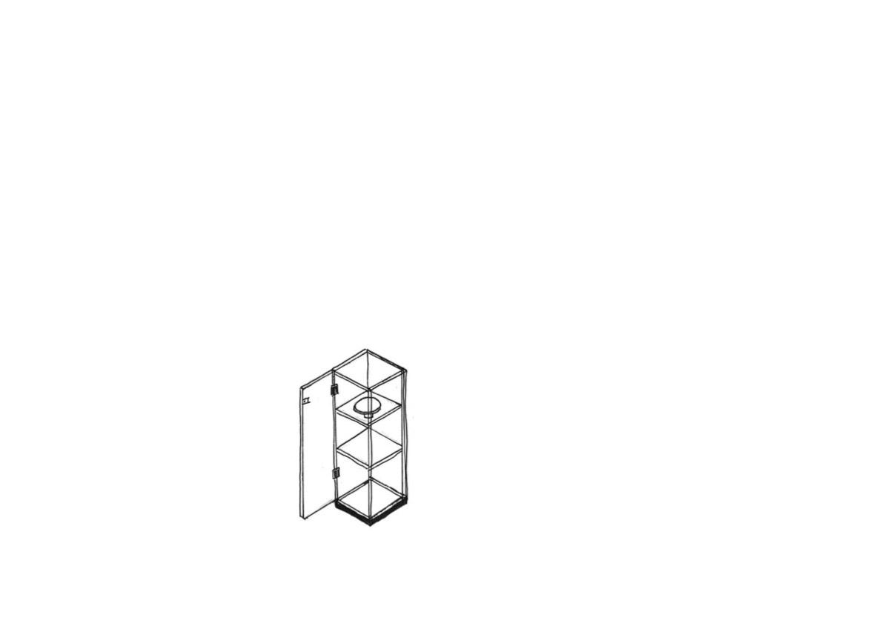
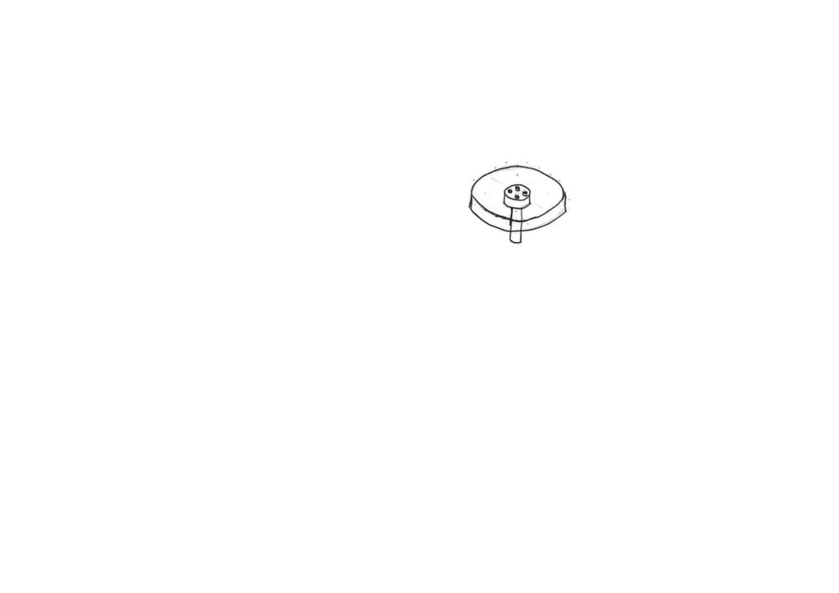
Design 2
The spinner would consist of a custom-ordered low power rating DC motor. Powered by 2x AA sized batteries. Alternative design could be that the motor is linked to wiring and batteries wouldn’t be needed. Making it more practical as the museum owner do not have to change the spinner’s battery ever so often. The chip will turn off the motor from spinning and the LED light strips to reduce energy consumption as requested by the specification.
This display spinner’s RTC and arduino chip board will be placed below the electric motor, and right above the battery holders. RTC will tell the arduino what time is it, so that the lights will be turned off during sleeping hours as mentioned in specification.
The flat bit of the display spinner can be laser cutted with an SVG file, laser cutted acrylic have a smooth surface, and the colour could be black, giving it a minimalistic modern feel.
At the top of this design, will consist of 4x PIR motion sensors, they will be pointed down and detect whether are there people around, these sensors will then communicate to the Arduino chip in the display spinner via copper wires which travels down the 4 metal rods on each corner.
However if the display spinner is powered by battery, this means it would be fully removable, so the user can choose whether to use the display spinner or not.
The display spinner will be able to carry displaying artifact and spin 360 degree as per requested by the specification. The speed needs to also be variable, and can be controlled by a remote control.
The glass door would be joint by steel hinges.
In between each glass pane layer, LED strips could be installed to provide lighting for the displaying artifact, variable resistor could even be installed to control the brightness to the user’s needs. LED is specifically used as they are efficient and doesn’t waste much power unlike incandescent bulbs.
The display spinner’s bottom bit will be a motor axle, which will be held together by a 3D printed motor flang and locked tightly to the motor axle, so the spinner will be spun.
In this design, there won’t be a button panel to control the ON/OFF of the DC motor and LED light strips. Instead, this design will rely on a remote control, which a bluetooth component needs to be installed.
Glass doors contain door lock to prevent theft.
The sides of this design would compose of 4 stainless steel or iron rods, that will give this design structural integrity, which the individual glass pieces will then be attached to the metal rods via glass-to-glass steel partitioning joints.
This design consists of glass panes for its outer panels to give it a minimalistic look.
Concept of motor flange. Which will be glued to the motor’s axle and display spinner.
This design have 2 glass panes in between, which will be held together by the 4 corner metal rods, these 2 panes acts to give this design 3 layers in between o display.
Bottom section would be made of custom-made aluminium block, which I will then drill out 4 holes on each ends to fit through the 4 supporting steel rods.
Silicone will be use as the adhesive to join the steel and glass together. Silicone is extremely strong and will hold the side glass panes together well.
The copper wires will run through these 4 metal rods, connecting the motion sensors at the top and the display spinner on the top layer, to provide these electronic components with a supply of electricity.
The corner of the glass panes on this design would be held up by custom-ordered glass-to-glass steel partitioning joints.

Slide 4
Design 2 – Development
70 cm
145 cm
145 cm
70 cm
70 cm
Since the displaying artifact needs to be at a height of 145 cm from ground, from here using the scales of this sketch, I have worked out what the dimensions of this design would approximately be.
Which, from the estimation above, the case will likely have a dimension of 0.7m X 0.7m X 2.15m.
For the height of this design, based on my research, which shows that eye level:height ratio is 1.04:1. Which if this display case were to be designed for world mean height of 167 cm, with an eye level of 160 cm. Further since humans tends to view things best from an angle between head tilt of 18-24 degree. Assuming that the person is standing 1 feet away, the displaying artifact needs to be at a height of 146 cm - 151 cm. Thus, in this design phase, I will assume that the height of the artifact displaying needs to be 145 cm from ground, from here I will use my drawing to estimate the dimensions of this design.
Glass-to-glass steel partitioning joint, or UV glue, or acrylic will be used to join the acrylic/glass panes together.
Overall, from the approximation drawings on this page’s top right, this means that the 7 respective pieces of glass/acrylic panes used will have a dimension of:
215 cm X 70 cm (4x middle panels)
70 cm X 70 cm (top & 2x layer panels)
From this information, I will determine whether is glass or acrylic suitable to be used for this design.
For the base, an alternative to rubberwood used can be stainless steel, which will give this design a minimalist look, and can even be spray painted if requested by the client.
Notes:
Draw details on glass joints.

Slide 5
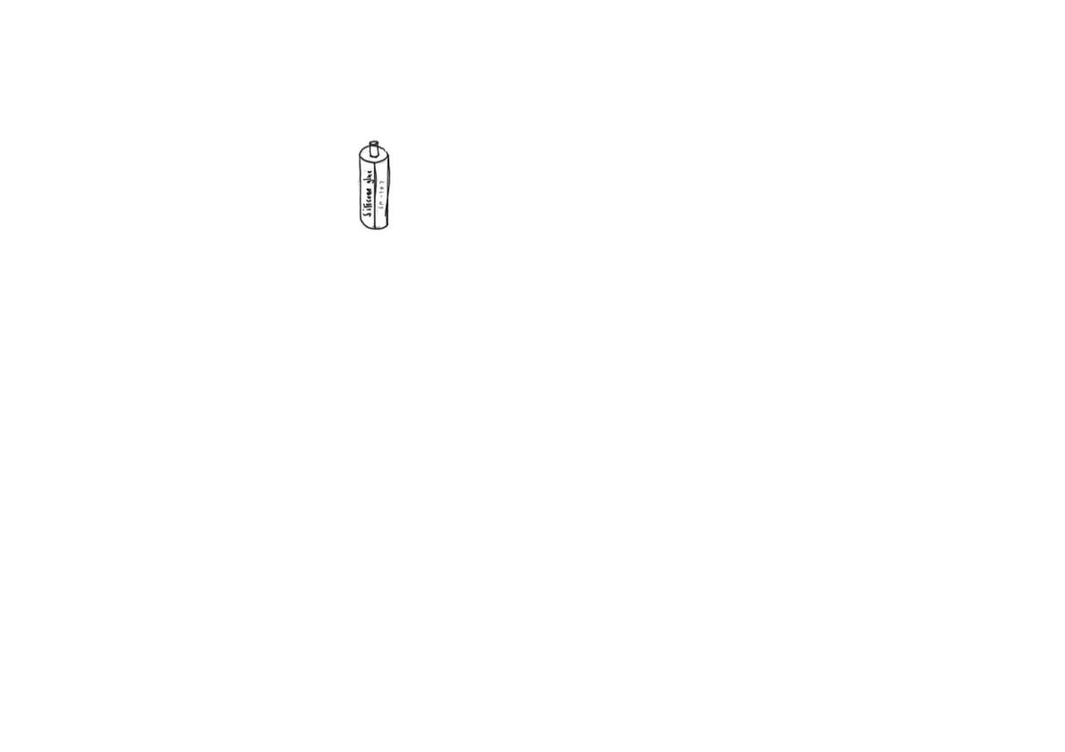
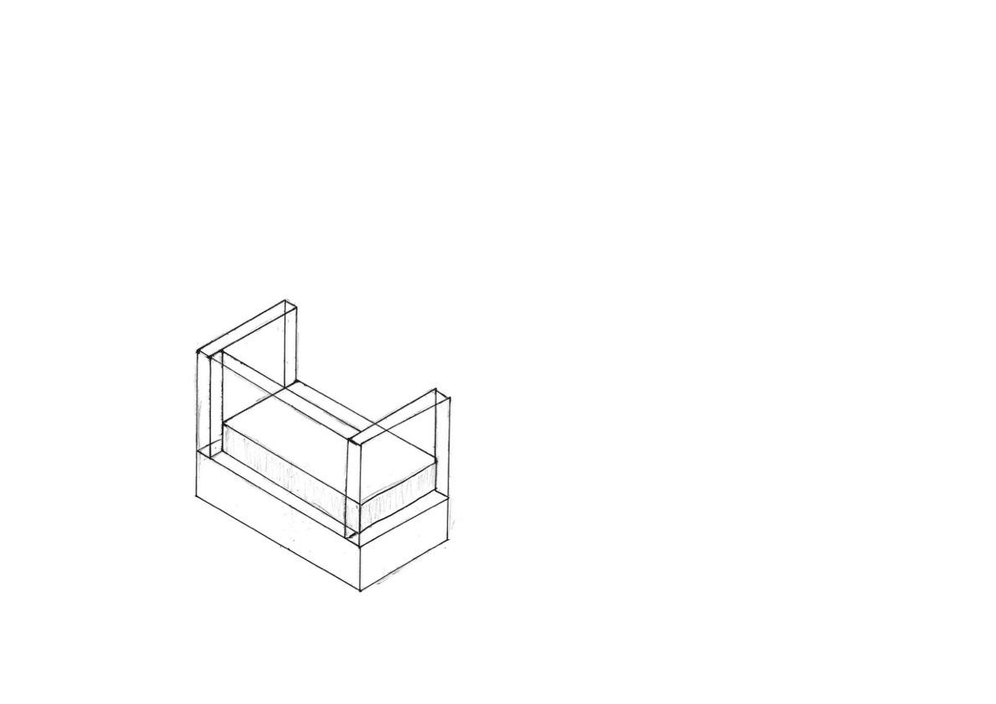
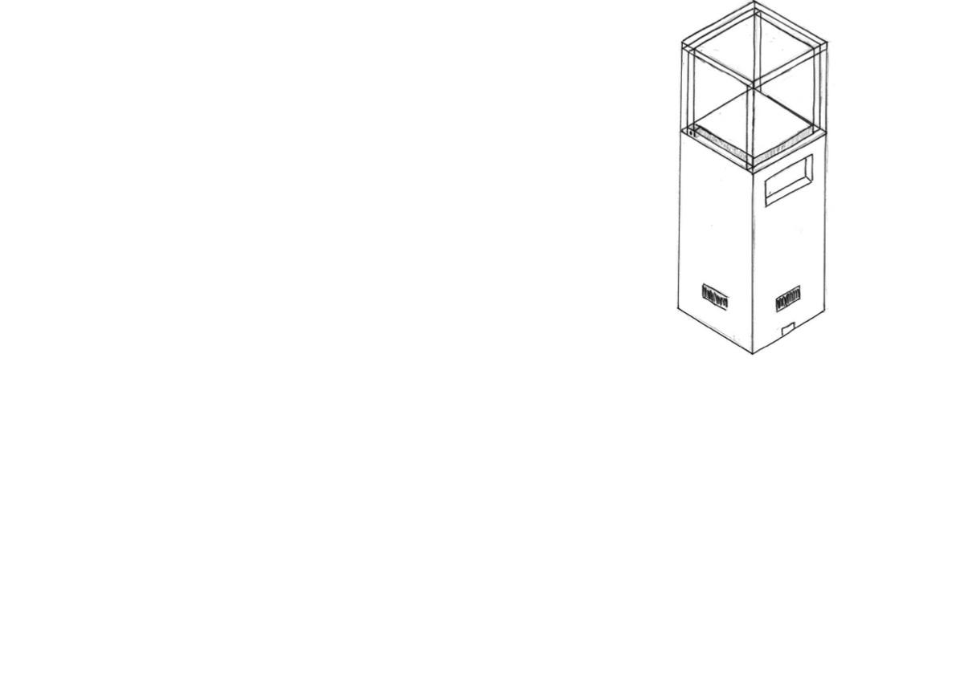
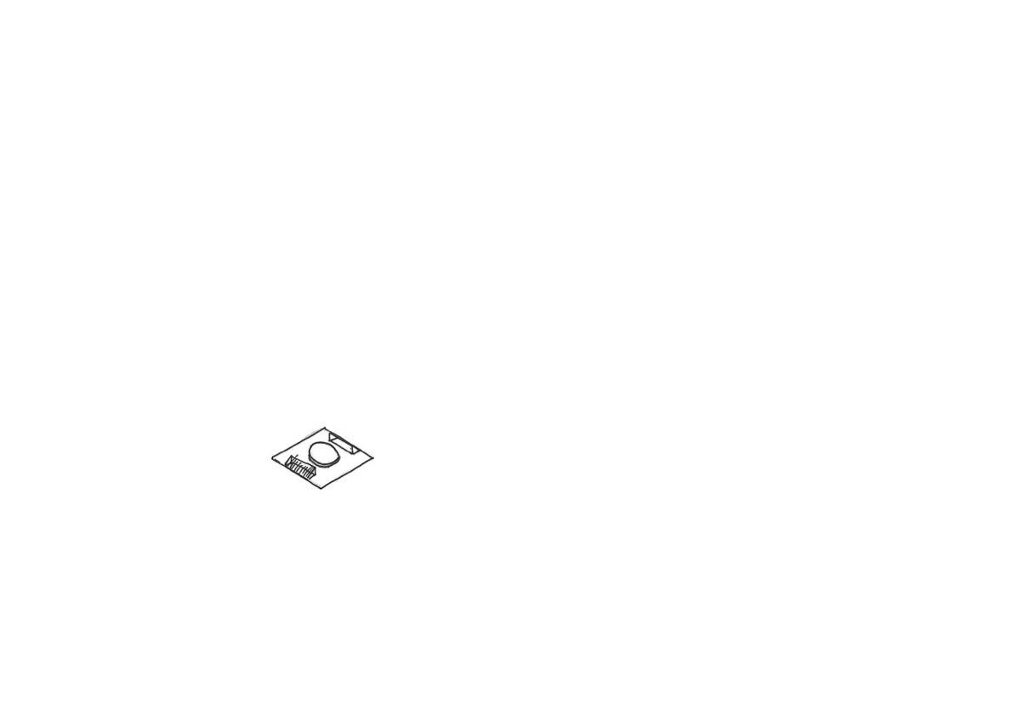
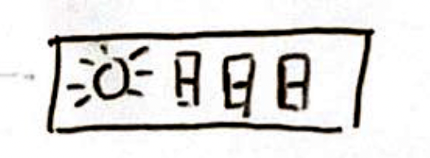

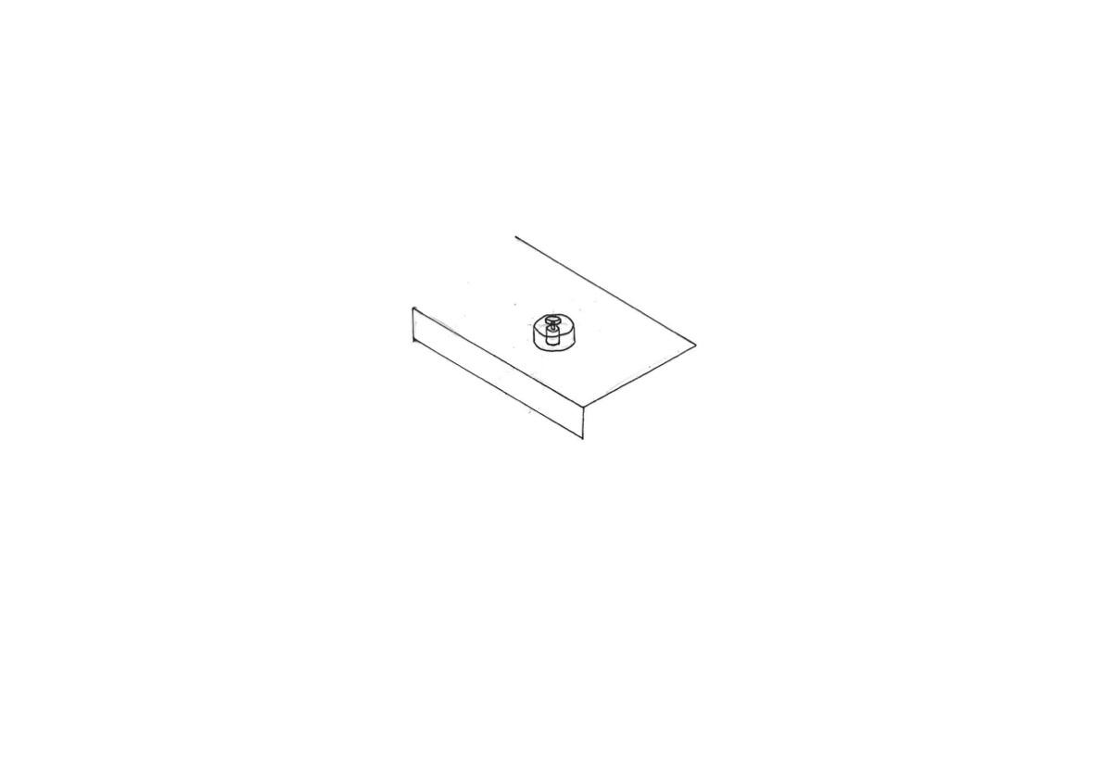


Design 6
The top bit, needs to be transparent in order for viewer to see through it to observe the object which is displaying. This part will likely be made of acrylic or glass. Chloroform would be used if acrylic, and UV glue or silicone could be used if glass is used in this part.
Lock mechanism to prevent theft.
Silicone will be use as the adhesive to join the steel and glass together. Silicone is extremely strong and will hold the side glass panes together well.
This section is where the LED lamps and display spinner will sit on, which this square area will consist of the display spinner and 2 LED lamps. LED lamps are used as they wasted 85% less energy than incandescent lamps, higher energy efficiency, as stated in the design specification, to reduce energy consumption overall, reducing carbon footprint.
An alternative to glueing the pieces of glass panels or acrylic together directly could be to use glass-to-glass steel partitioning joint.
In this design, the transparent bit, or the acrylic case will be an independent bit, sort of 5 acrylic face panels glued together, this means the case wouldn’t be directly attached to the main display case. So, in order to hold the acrylic section in place, I will likely need to create a change in height, which will act like a track for the acrylic section to sit on. A good reason for acrylic instead of glass used here is that acrylic is fairly light, which means its more easily removable, making maintenance and installation much easier for the museum worker to clean or change the displaying artifact, as stated in the design specification.
This is where the button panels are located in this design. The button panel will control the speed of which the motor is spinning, and whether the lights in this sphere display case is on or not. The RTC and Arduino microcontroller will be placed behind this button panel. The RTC will tell the Arduino to turn off the lights and motor off during closing hours to further reduce energy consumption, as stated in the specification.
This design will incorporate 4 motion sensors, 1 on each side, to detect motion to know when to turn the LED lights and DC motor on or off. Components are turned off when no one is around in order to reduce energy consumption as stated in the specification.
A lock mechanism needs to be incorporated to prevent unauthorised access/touching/theft of the displaying artifact. The display case needs to aim to give the displaying artifact a safe and secure environment to display in.
This is where the extension cable will be inserted, to supply electricity to all respective electrical components in this design. Mains electricity will be converted to 6V DC for safety purposes, to prevent risk of death from electrocution as mentioned in specification
The bottom half of Design 5 will be made of rubberwood, and then painted black and sprayed clearcoat, as requested by the respondents in the survey I’ve conducted.
Inner section will be hollow to reduce weight of this design to allow ease of relocation and moving around, as mentioned in specification.
The flat bit of the display spinner can be laser cutted with an SVG file, laser cutted acrylic have a smooth surface, and the colour could be black, giving it a minimalistic modern feel.
Cross section of how the motor will be placed in order to connect to the motor flange and display spinner. Display spinner will spin the displaying artifact 360 degrees to give the viewer a great viewing experience as the exclusivity of the artifact is emphasised as mentioned in the specification.
Like design 5, Design 6 will incorporate Mitre joints for the main rubberwood panels. Based on my research on wood joints, the usage of mitre joints for wood panels at this size is likely to be easier.
Ergonomic Note
The height of this design needs to be appropriate and ergonomic, in such that the user can easily observe/view the displaying artifacts in the display section without having to tiptoe or bend over, as mentioned in the specification.
The display spinner’s bottom bit will be a motor axle, which will be 3D printed and locked tightly to the motor axle, so the spinner will be spun.
Notes:
Door lock. Crop out finger joint horizontal. Flange coupling

Slide 6
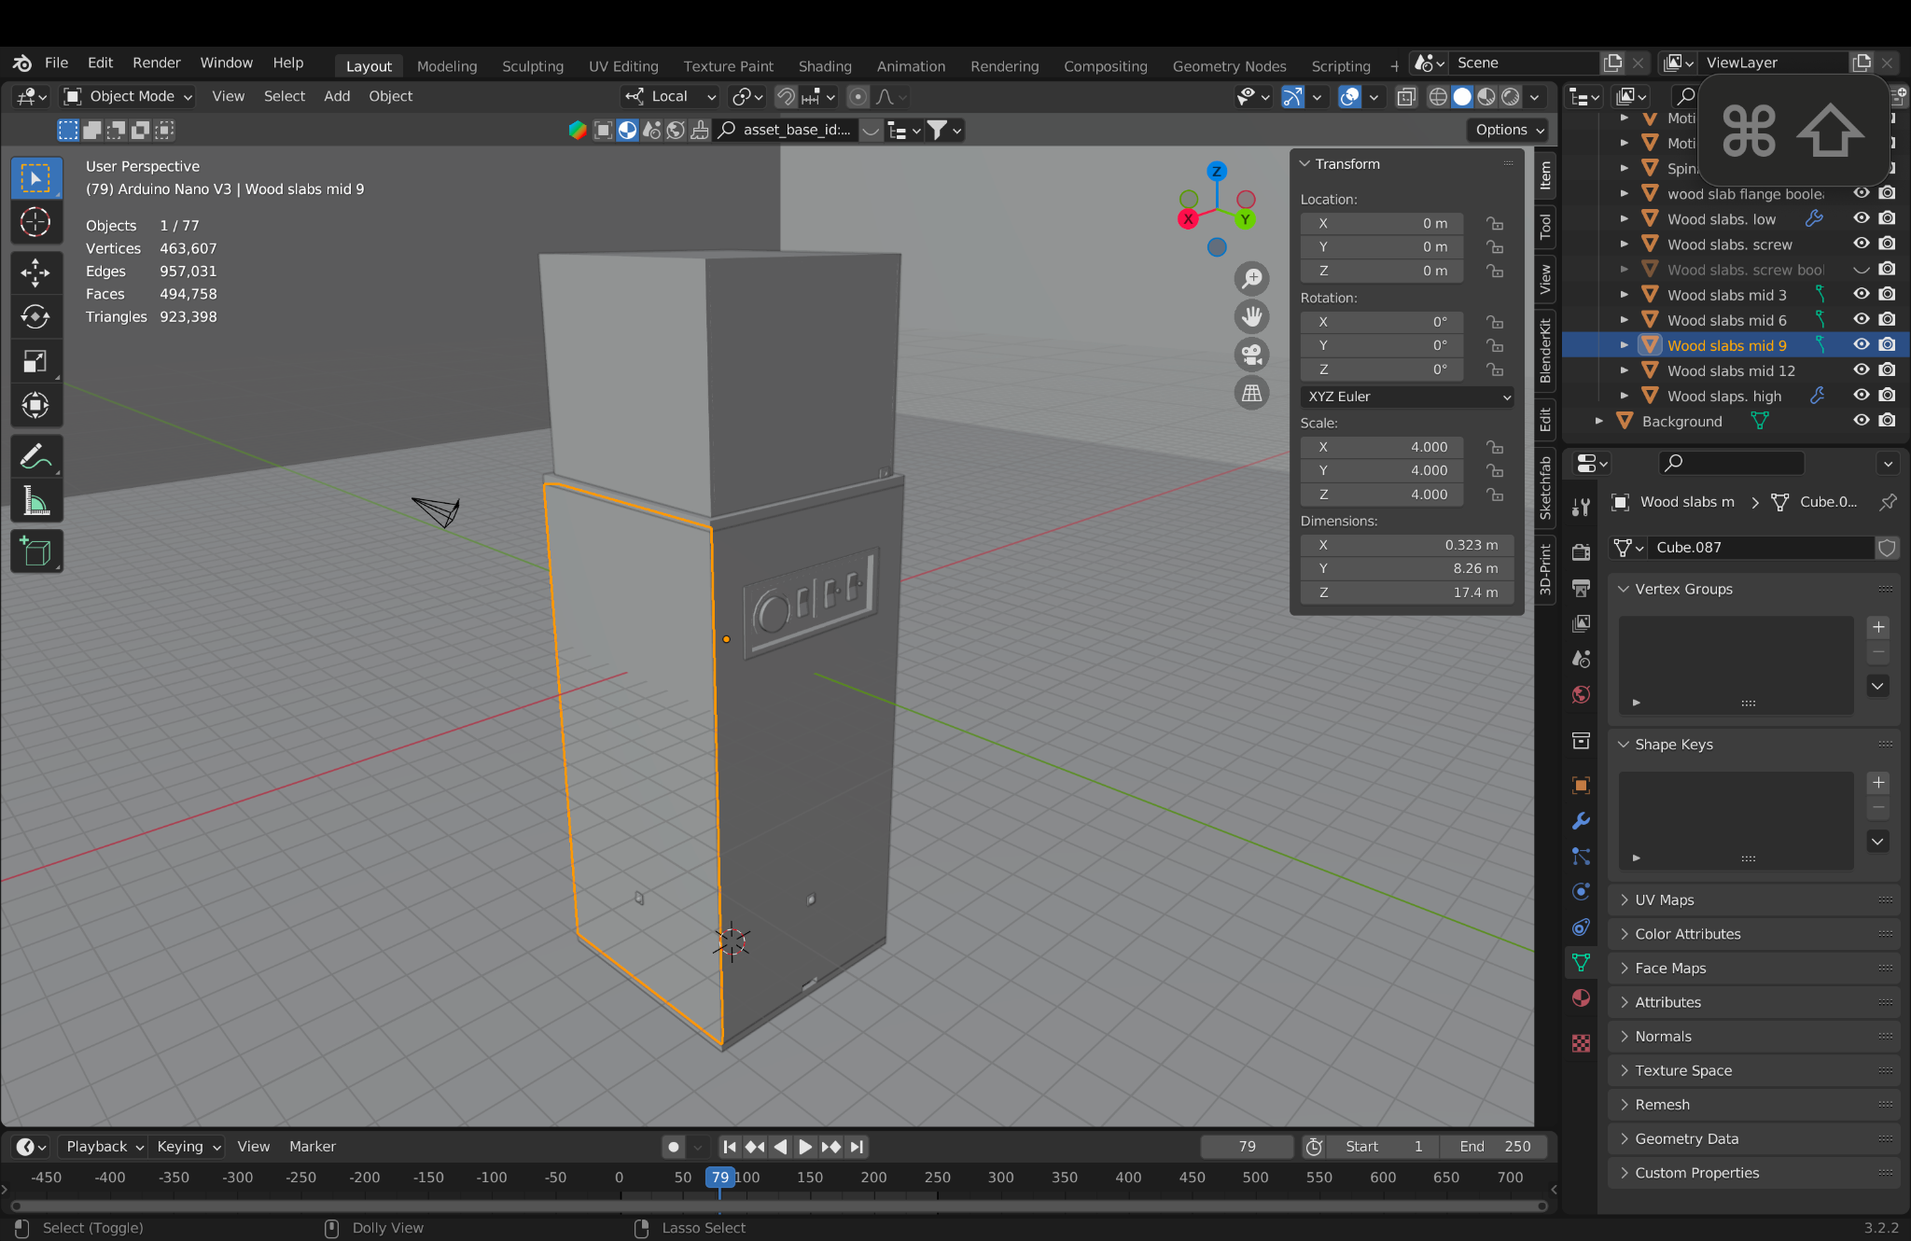
Design 6 - initial CAD model
This is Design 6 made in the CAD software blender. Everything is to a scale of 1:15 in the software and the aim is to be able to get accurate measurements of this design and then test and tune these measurements gradually.
Notes:
Ratio of IRL to blender is 1:15

Slide 7
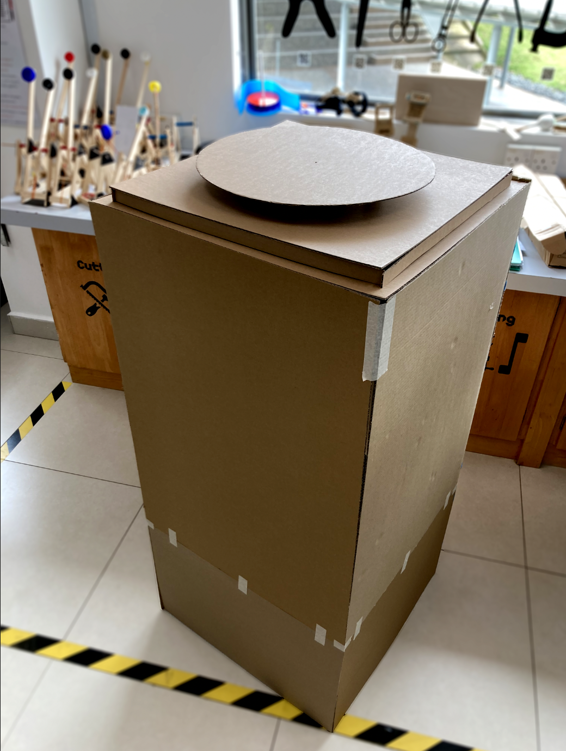
Physical model testing and iterating
Testing egonomicality of display case height
This is design 6, the design in which I decided upon. In order to meet my final specification, of granting the viewers/visitors the best, optimum viewing experience. As mentioned in the specification, the display case’s height needs to be optimum. This is because, if the height of the display case is made too low, users needs to bent down in order to view the displaying artifact. However, if the height of the display case is too tall, users needs to tiptoe in order to view the displaying artifact.
Thus, I have decided to make a physical model of Design 6, out of cardboard models. Which, this design have a height of 121.5 cm initially, based on 2 pages before. With sides of 55cm, this display case will have a displacement of 0.4 m³.
Furthermore, with this cardboard model (as seen with image on the left) made at 1:1 ratio, I aim to also test the motion sensor placement, and lighting placement in the future, to meet my specification.
In the pages below, I will discuss about the issues that I have encounter with this initial dimensions, and the iterations I have made in order to solve these issue and fulfill my final design specification.
Notes:
Shirei child height - 131.5 cm
Eye level - 107.5 cm
Original design eye level - 121.5 cm
Tuned design - 121.5 cm - 14 cm = 107.5cm
14 cm have been cut down to fit eye level of child with height of 131 cm (8 yrs old world avg)

Slide 8
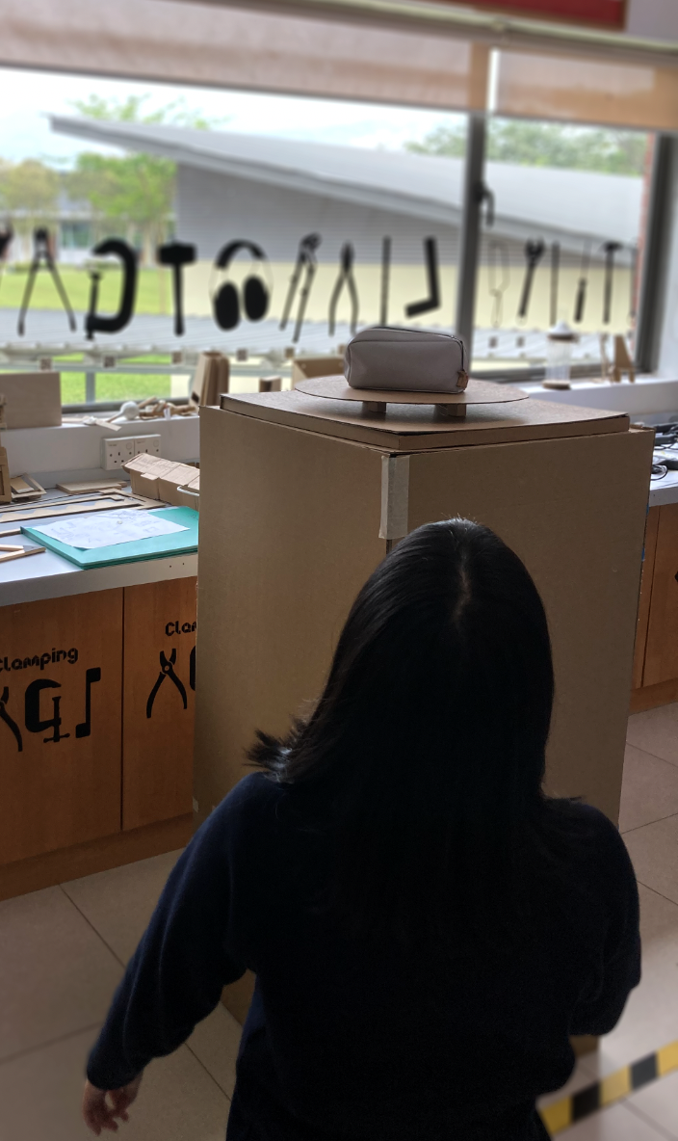
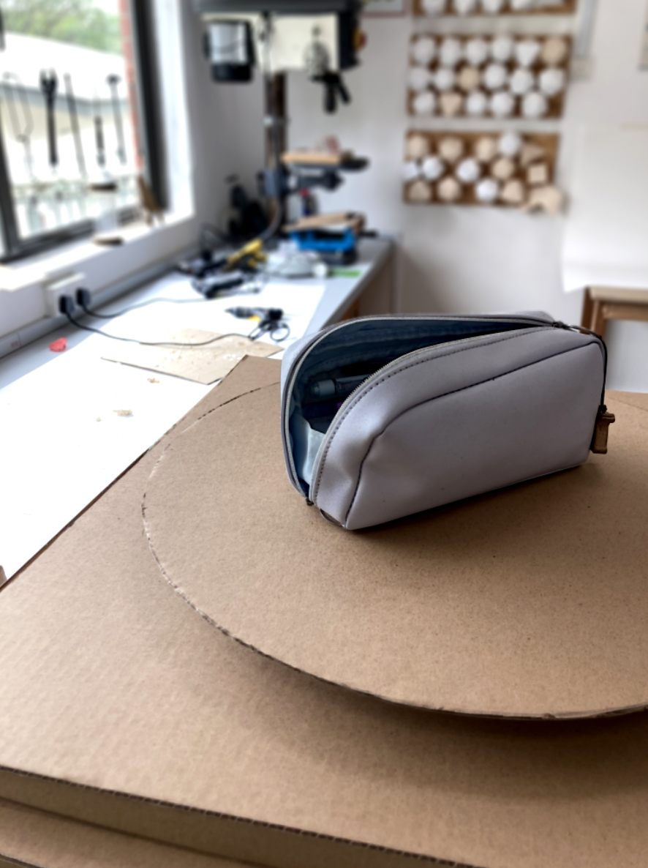
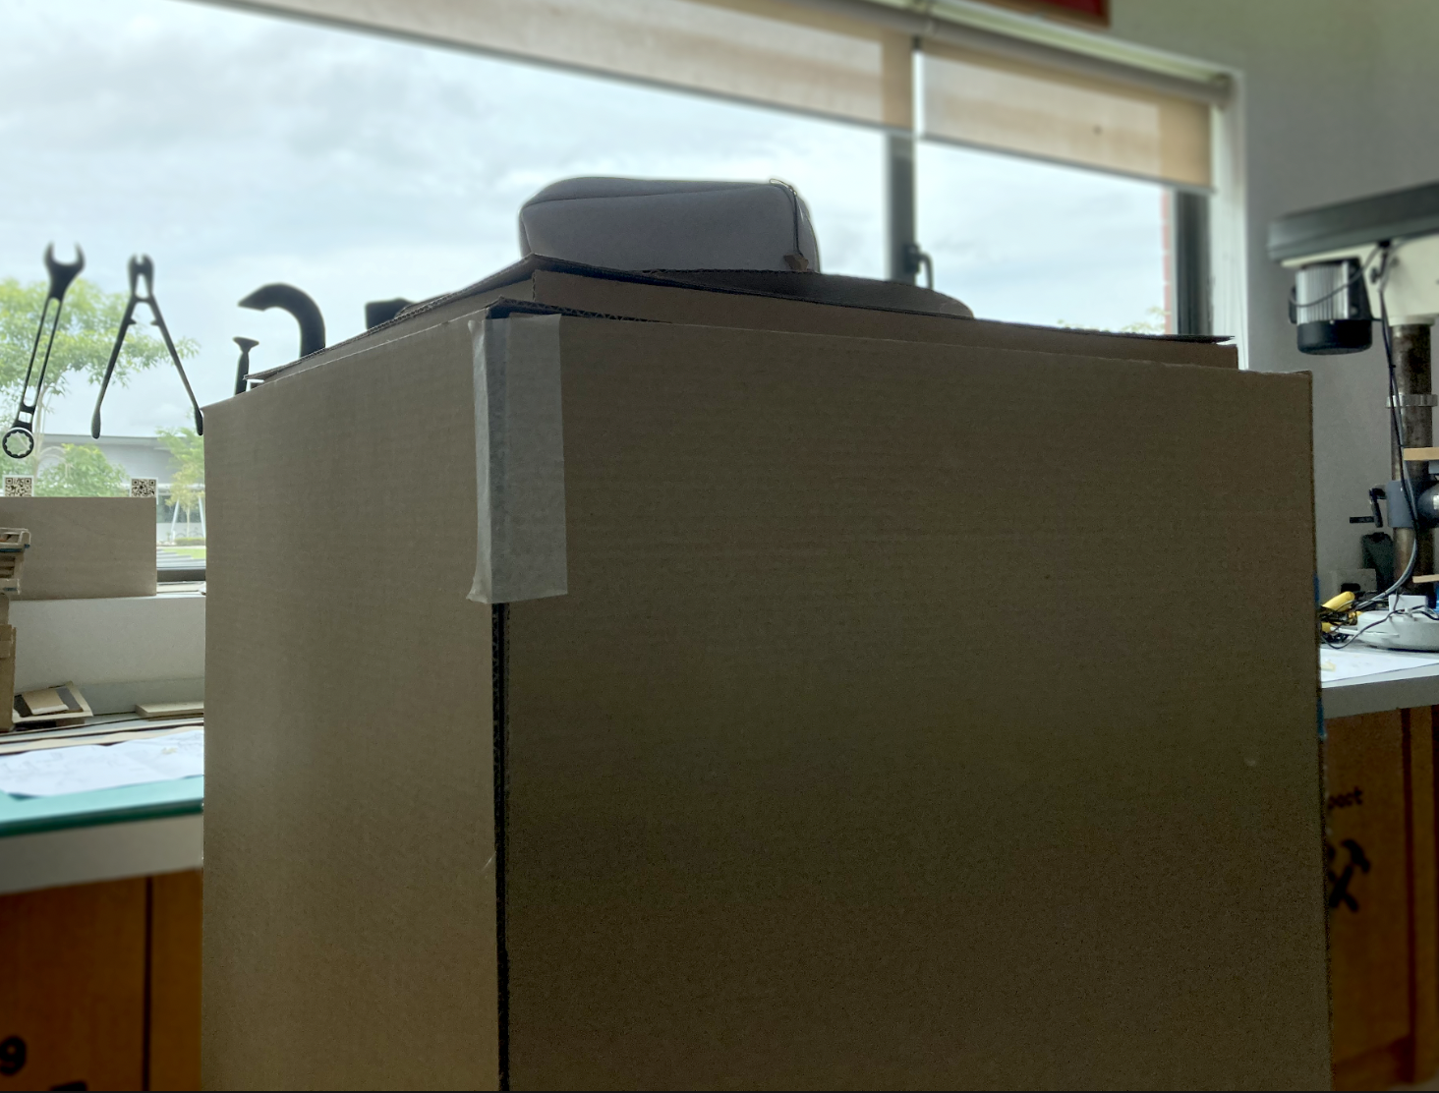
Physical model testing and iterating
Testing egonomicality of display case height
After the 1:1 ratio cardboard model is made, I have then begun testing its dimensions ergonomically, ie whether is the display case’s height’s appropriate for viewers of the displaying artifact. The first issue that arises is the height of the display case, with the displaying artifact placed at 126 cm, as seen from figure 50.4, the percentage of eye to eye level if approximately 1:1.04, this means anybody viewing the displaying artifact needs to be at least 131 cm tall in order to view the displaying artifact comfortably, not to mention that the 126cm eye level height is only accounting for the display spinner’s top part, meaning the viewer is likely to only having their entire line of sight only seeing the display spinner, completely missing out the top bits of the displaying artifact, interrupting their viewing experience, which completely negates my final specification, of mentioning of giving the viewers, a great viewing experience.
This height placement would be fine if a tall person were to view the displaying artifact (as seen on figure 50.2, as I have a height of 175 cm). However, if a short person were to view the displaying artifact, assuming if the person have a young age, which according to statista.com, in the UK, the demographics 60.8% of 6-10 year olds in the UK have visited museums more than once annually. In which 6 year olds, have an average height of 116.5 cm, according to statista.com. Meaning 6 year olds and above will have an eyeline level of at least 112 cm.
Which, in figure 50.1, I have asked my friend to knee down, which she would be at height of about 119 cm, mimicking the height of a 6 year old, in which she have shown to have a terrible viewing experience, due to the display case being way too tall, with figure 50.3 being her POV.
Thus from this, I have realised that I need to reduce the display case’s height, in order to ensure that my final specification is met, in which viewers needs to have a great viewing experience, and the height of the display case cannot be too high.
Figure 50.1
Figure 50.2
Figure 50.3
Figure 50.4
Statistics used: https://www.statista.com/statistics/421057/children-visiting-museums-england-uk-by-age/

Slide 9
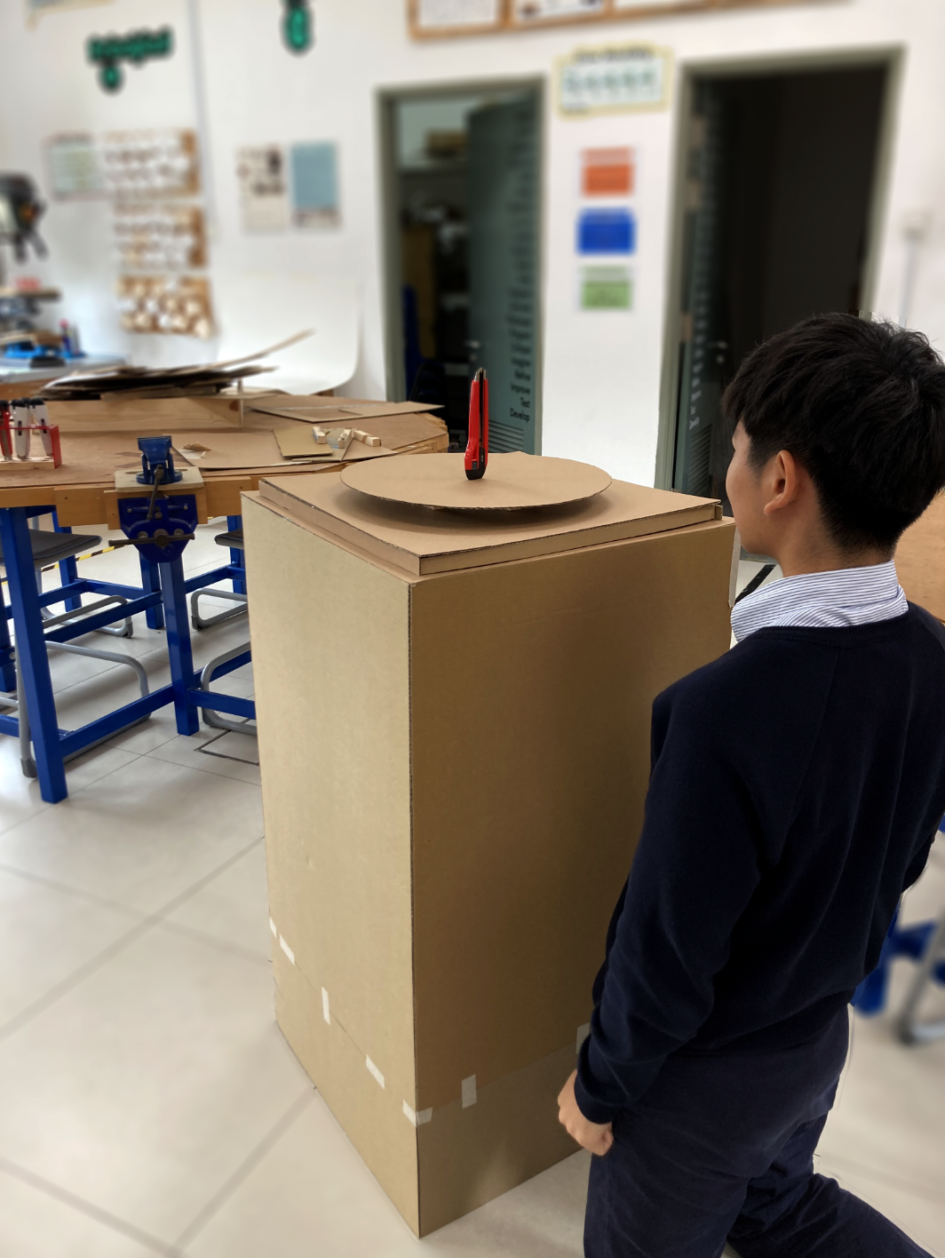
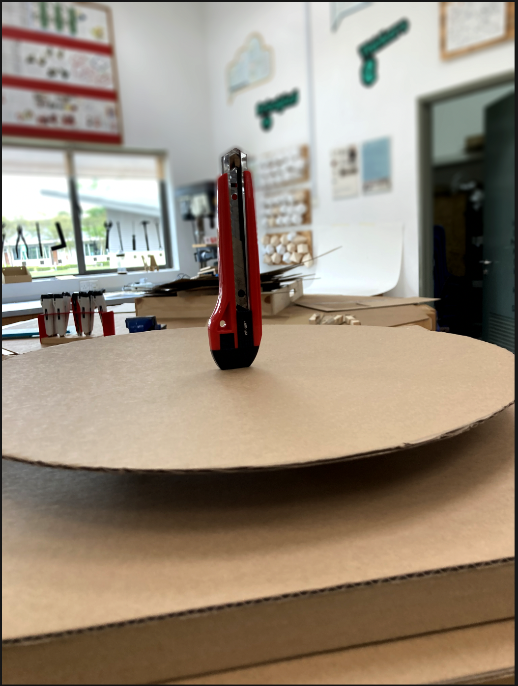
Physical model testing and iterating
Testing egonomicality of display case height
I have decided to cut down the cardboard model’s height, until the display case’s height (without the top transparent enclosure case, likely made of glass or acrylic), is below the eye level of the average 6 years old, which is 116.5 cm. In thus, I have cut down the display case by 14 cm, from an initial height of 121.5 cm, to now a height of 107.5 cm, which is now below a 6 year old’s eye level of 116.5 cm.
To test whether does this approach work, I have then asked my friend, Roy, as seen in figure 51.1, he is on his knees in order to mimic a short person’s viewing experience, which from here, he has a height of 132 cm, and eye level of 126 cm. In which, he have had a great viewing experience now compared to before. As seen in figure 51.2, which is Roy’s POV as he is on his knees, he is now able to look at the object which is displaying at a comfortable height, which means a person at this height, ~130 cm, now don’t need to tip toe in order to view the displaying artifact, which this height now meets my design final specification.
I could even cut the model further down, to 90cm for example, to accommodate for the average 6 year old’s eye level of 116.5 cm, however, in doing so, means that adults, or taller people, would need to bent over to view the displaying artifact. And thus I have decided to remain at this height, of 107.5 cm, not too tall, not too short, the Goldilock Zone. Which for this reason, is why I asked Roy to be at the height of 132 cm, instead of Shi Rei’s kneel down height of 116.5 cm.
From this result, I have then reduced the height of the display case in my CAD model, which I will be providing a render of the display case’s height before and after in the coming page.
(Image on left, figure 51.1)
Roy on his knees (~132 cm) testing out what the POV of younger children would look like.
(Image on right, figure 51.2)
A person standing at 132 cm’s point of view whilst looking at the object displayed on the display case.

Slide 10
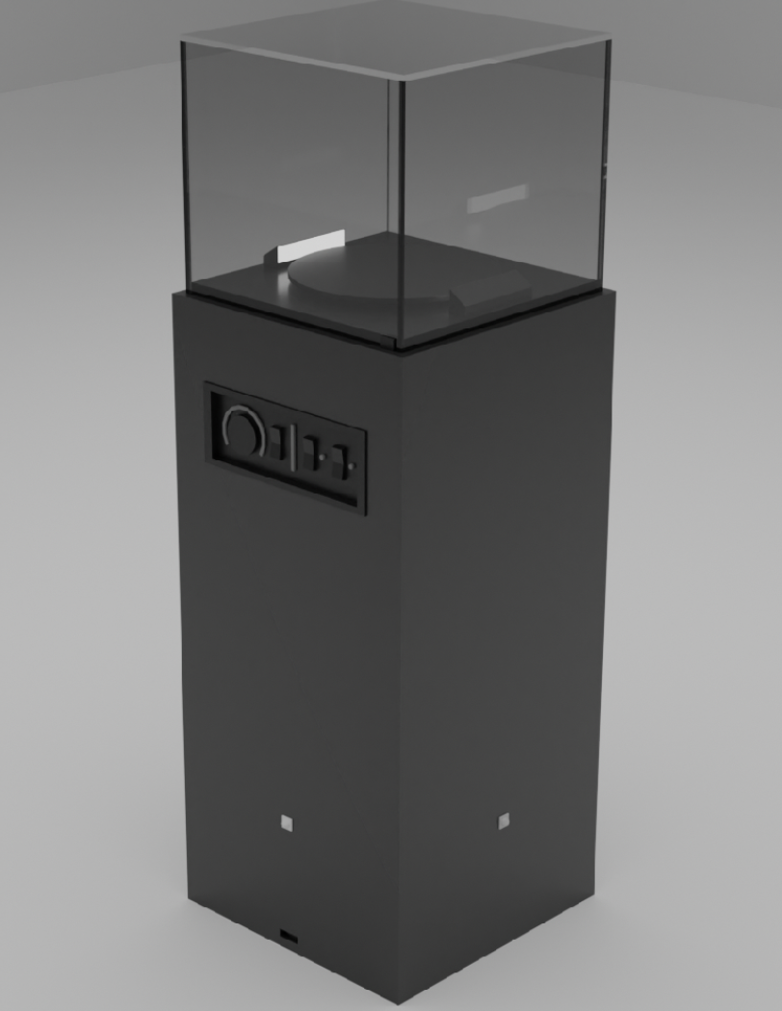
Design development – button panel placement
Problem
After rendering out the 2 pictures showcasing the results of “physical model testing and iterating”. I have realised that the button panels for the original design 6 is slightly too apparent and obvious. The issue that arises is that, if the button panel designed in the display case is large, and in the center, this means the button would be the first thing the user sees in their sightline.
The first issue is that, the user will likely now be interested in what does the button do, instead of what the display case is displaying. Furthermore, if the buttons are falsely tweaked with, the optimum speed of the electric motor, and the optimum brightness of the lights which are shining on the displaying artifact would now be affected and no longer be permanent.
It could also lead to risk of vandalism or the button panels breaking due to overuse, as, for an example, if the display case were to be used in my school to display student’s artwork, the students in my school tends to be fairly curious and naughty, and placing the button in an obvious spot that comes to sight clearly risks of the buttons being played with in the wrong way, which risk of having the button panels then needing to replaced, which would cost money, and also that the displaying artifact’s lighting and the speed which the display spinner is spinning is now affected and compromised, affecting the viewing experience for the rest of the viewers/visitors.
Development decision
Thus, I have decided to hide the button from plain sight by using the human psychological factor, inattentional blindness.
Inattentional blindness is a psychological phenomenon where an individual fails to notice something in their visual field because their attention is focused elsewhere. In my display case, this can be applied to hide the button panels by placing them in areas where a user is less likely to look, or by making them less visually distinct from the surrounding elements.
For example, a button could be placed in a corner, or have a muted color that blends in with the background, and also reducing the size of the button panels in itself. The key is to make the button less noticeable, so the user's attention is not drawn to it.
Action
Based on the problem pointed out, I have decided to exploit the human psychological factor, inattentional blindness, by redesigning the button panels so that it is smaller and hides away at likely at a much lower position, instead of large and at center as demonstrated with the image on the left.

Slide 11
Physical model - realisation and material choice
From this cardboard model made of design 6, I have decided that the main wood panels will be made out of rubberwood, which is a strong hardwood. There are a few reasons for this, firstly is that rubberwood is readily available in my school, meaning I will not have to purchase it, which will lower costs. Furthermore, from this cardboard model, I have realised that the display case itself will likely be under a lot of weight and pressure. Thus, a strong material needs to be used in order to hold the display case in place.
For the display spinner, after conducting research in materials available in my school’s store room, I have concluded to use laser-cut 5mm black acrylic for the display case, as acrylic at 5mm is fairly strong and can hold a lot of weight, which from my previous research, I have to design a display spinner that can hold up to 10 kg in weight, which 5mm acrylic is more than sufficient to hold this level of weight.
Furthermore, the top, transparent section of the display case also will be made out of acrylic instead of glass, as after making out the top section out of cardboard, I realised that the part needs to be lifted and move around. And even a 1:1 transparent section is fairly heavy and impractical to move around due to its size and weight. Thus, I have decided to make the transparent section out of acrylic, instead of previously considered glass. As, acrylic weighs significantly less compared to glass, making relocation of the display case more practical, fitting my design specification. Furthermore, acrylic case is less of a safety hazard, as acrylic case even if dropped, wouldn’t shatter or send glass shards flying around, potentially causing blindness.
(Image of physical model)

Slide 12
Initial Cutting list
Component | Length (mm) | Width (mm) | Height (mm) | Thickness (mm) | Quantity | Material
Middle Wood panels | 550 mm | 15 mm (thickness) | 1020 mm | 15 mm rubberwood | 4 | Rubberwood
Acrylic section (middle) | 5 mm (thickness) | 506 mm | 440 mm | 5 mm acrylic | 4 | Acrylic
Acrylic section (top) | 506 mm | 506 mm | 5 mm (thickness) | 5 mm acrylic | 1 | Acrylic
Bottom wood panel | 550 mm | 550 mm | 15 mm (thickness) | 15 mm rubberwood | 1 | Rubberwood
Top wood panel (top) | 496 mm | 496 mm | 18 mm (thickness) | 18 mm rubberwood | 1 | Rubberwood
Top wood panel (bottom) | 550 mm | 550 mm | 18 mm (thickness) | 18 mm rubberwood | 1 | Rubberwood

Slide 13
Component list and details
Component | Length (mm) | Width (mm) | Height (mm) | Thickness (mm) | Quantity | Material | Details
Jumper wires | 10mm - 20mm | ~ | ~ | ~ | 80-100 | ~ | Jumper wire is needed to connect all components together. Will be purchased from local electrical store.
Copper wires | 500mm - 1000mm | ~ | ~ | ~ | 10-20 | ~ | I need to cut out a few longer copper wires for longer electrical connections. These custom cut-out copper wire will be 1m in length.
DC motor | 80mm | 32mm | 34mm | ~ | 1 | ~ | My teacher have purchased a 30 MYR, 5 Nm, High torque low speed motor. A Y370 6V DC motor.
Arduino Mega Chip | 100mm | 50mm | 10mm | ~ | 1 | ~ | Arduino Mega chip is needed to handle all computational processing. Will be purchased from local electrical store.
iKEA harte lamp | 175mm | 200mm | 325mm | Ø 15 mm | 4 | ~ | 4x ikea harte lamps will be purchased online to light up the display case.
Extension cable | 2000mm | ~ | ~ | ~ | 1 | ~ | Extension cable will be purchased from local electrical store to supply electricity to all electronic components.
USB cable & port (For Arduino chip) | 500 mm | ~ | ~ | ~ | 1 | ~ | A USB cable port and cable is needed to supply electricity to Arduino chip. Will be purchased from local electrical store.
8 channel relay board | 110 mm | 50 mm | 20 mm | ~ | 1 | ~ | 8 channel relay board will allow the Arduino board to control the 4x iKEA lamps.
ON/OFF buttons | 20 mm | 20 mm | 50 mm | ~ | 4 | ~ | 4x ON/OFF buttons will be purchased to turn the ikea lamps on or off. Will be purchased at local electrical store.
Potentiometer and knob | 25 mm | 17 mm | 50 mm | ~ | 1 | ~ | A potentiometer knob will be purchased from local electrical store. The knob will control the speed of the DC motor.
Display spinner | Ø 386 mm | Ø 386 mm | 15 mm | 5 mm | 1 | Black acrylic (Not clear) | Display spinner will be cut out by a laser cutting machine. Will consist of 3 layers of 5mm acrylic joining together to form a thickness of 15 m
Lock mechanism – gym pin | 50 mm | Ø 7 mm | Ø 7 mm | ~ | 4 | ~ | I will be purchasing gym pins on an online platform for the lock mechanism. 4 of them will be needed to secure the acrylic case onto the top wood panel.

Slide 14
Component list and details
Component | Length (mm) | Width (mm) | Height (mm) | Thickness (mm) | Quantity | Material | Details
Motion sensor holders | 60 mm | 60 mm | 30 mm | 5 mm | 4 | PLA (3d print), Black. | Motion sensors needs a holder to hold it securely to the display case. These pieces will be 3D printed using my school’s 3D printer.
PIR Motion sensors | 32 mm | 24 mm | 17.2 mm | ~ | 4 | ~ | 1 motion sensor will be attached on each side of the display case via the motion sensor holder. It will detect motion to meet specification; will be bought in electrical store.
Button panel | 212 mm | 90 mm | 30 mm | 5 mm | 1 | PLA (3d print) & Laser Cut acrylic. Both black | Button panels will hold the ON/OFF buttons and potentiometer knob in place. The inner layer of button panel will be laser cutted acrylic, and outside will be 3D printed.
Motor driver holder | 50 mm | 50 mm | 25 mm | 5 mm | 1 | PLA (3d print) | Motor driver holder will be 3d printed to hold the motor driver in place. The motor driver will be screwed onto the holder, which this holder is then screwed onto the top wood panel.
Motor driver – BTS 7690 | 50 mm | 50 mm | 40 mm | ~ | 1 | ~ | Motor driver will be purchased online. Motor driver will allow the Arduino chip to control the speed of the DC motor.
Breadboard | 170 mm | 55 mm | 10 mm | ~ | 1 | ~ | A breadboard will be purchased at an electrical store. Used for prototyping and connecting the electrical components together, providing ground and power supply at 3.3V or 5V.
RTC | 28 mm | 27 mm | 8.4 mm | ~ | 1 | ~ | RTC will be purchased at an electrical store. RTC tells Arduino time accurately, to meet specification.
AC/DC adapter | 1200 mm | ~ | ~ | ~ | 1 | ~ | AC/DC adapter is needed to provide the motor electricity at a high wattage of 12W. They are readily available at my school.
Solder (soldering iron) | ~ | ~ | ~ | ~ | ~ | ~ | Soldering iron is needed to connect each respective electrical components securely.
Motor flange | Ø 200 mm | Ø 200 mm | 60 mm | 10 mm | 1 | PLA (3d print) | Motor flange will be 3D printed with my school’s 3d printer. A flange is needed to connect the DC motor’s axle to the display spinner.
Motor holder | 120 mm | 85 mm | 45 mm | 10 mm | 1 | PLA (3d print) | Motor holder will be 3d printed with my school’s 3d printer. The holder will hold the motor in place, which the motor will be screwed onto the holder, which is then screwed onto the top wood panel.
Lamp holders | 60 mm | 60 mm | 75 mm | 5 mm | 8 | PLA (3d print) | Each iKEA lamps will be held by 2 lamp holders at an angle. These lamp holders will be 3d printed by the school’s 3d printer.

Slide 15
Production Plan – Part 1: Display spinner, motor holder, motor driver
Process/task | Equipment & Materials | Scheduling | Quality control | Risk Assessment
Designing the laser cutting SVG file for the top base of the display spinner and its lower edges. Then, the part is cut out with a laser cutting machine. | Laser cutting machine, Adobe Illustrator (SVG software), Blender (CAD software), Ruler, 5 mm Black Acrylic. | 20 minutes | I will use a ruler to measure the dimensions of my test model to ensure that the Display spinner I am laser cutting will be at the correct size. I will also use Blender, a 3D CAD software, to visualise how appropriate the display spinner looks from its rendering functions. I will then use Adobe Illustrator to create the SVG file for the display spinner, which the SVG file will then be inputted into the laser cutting machine. | I will close the cover of the laser cutting machine when the machine is running to avoid temporary blindness due to looking at the laser when the machine is operational. Avoid touching the machine’s laser cutter to avoid skin burns, and also I will take a break every 20 minutes from working on my computer, to avoid the risk of nearsightedness. And I will sit in the correct position when working on the computer to avoid the risk of getting back pain.
Electric motor soldering and wiring, linking motor to its driver (BTS 7690 motor driver) | Soldering paste, Soldering holder, Solder (tin + lead alloy), 2x pin header, female-female jumper wires, male-male jumper wires, soldering iron | 15 minutes | Repeating process by removing the solder if the pin-holder is not joined correctly (leads to an incomplete circuit) to the electric motor, and I will apply the correct amount of solder, to avoid the risk of not being able to repeat this process (too much solder means I likely won’t be able to remove the solder with a plier without damaging the motor). | Turn off the Soldering iron and put the soldering iron on the holder when not in use, and keep it out of touch away from my classmates and myself when working to avoid heat burns as the soldering iron gets up to >300 degrees Celsius when turned on. Use a rubber mat beneath me to avoid soldering iron permanently joining onto the table when it drips.
Designing the STL file for the electric motor flange to connect to the display spinner. And also the STL file for the electric motor’s holder, the holder will hold the electric motor in place in the display spinner. Then, the STL files will be input into the 3D printers on campus. | Blender (software), Fusion 360 (software), clamp (measuring the diameter of the axle), ruler (measuring, double-checking the diameter of the axle, and measuring the size of display spinner), 3D printer, PLA (black colour), pencil, eraser, notebook | 90 minutes | I will initially draw out the design on the notebook to have an idea of what the motor flange will be like. And, after exporting the STL file from Blender, I will use the FEA in Fusion 360 to back-test the component and to double-check that the STL file will be at the correct size and measurement. | I will take a break every 20 minutes from working on my computer, to avoid the risk of nearsightedness. And I will sit in the correct position when working on the computer to avoid the risk of getting back pain. When the 3D printer will be 3D printing, I will ensure that the printer’s cooling fan’s airflow isn’t blocked in any way or form to avoid overheating.
Screwing in the PLA motor holder and motor onto the display case. | 4 mm pan-head screw, screwdriver, 3 mm ø drill bit, drill driver | 15 minutes | To ensure that I don’t misalign the screw’s positions, I will initially mark out the places where I will drill the screws, and then when drilling check on the screw every 6 seconds to ensure it’s being drill in vertically. | The screw can get really hot when drilling into PLA and rubberwood, I will pay attention and be careful plus in the process of drilling I will wear gloves.
Applying adhesives between the top base of the display spinner and its lower edges. Then, also applying adhesives between the motor flange and the display spinner. | Epoxy and hardener resin, mix at a 50:50 ratio. Lollipop stick to mix and apply evenly. | 20 minutes | To ensure my components are glue to the right position, I will mark out with a pencil, and use a ruler to constantly measure from the edge and ensure my components are glue to the centre. To ensure the joint will be strong, I will apply pressure when the parts are curing, and let the epoxy cure for 30 minutes. | Epoxy resin if it gets onto my eyes would be fairly problematic, and thus I will remain alert on not touching my eyes and wearing goggles, and wearing rubber gloves as epoxy resin if which got onto my fingers would affect my writing abilities. Moreover, I will remain cautious by not spilling the epoxy over the workshop or the tables to avoid damaging the school’s property.
Screw the motor holder and motor driver holder onto the wood panels. | 4 mm ø X 20-30 mm pan-head screw, screwdriver, 3 mm ø drill bit, drill driver | 20 minutes | To ensure that I don’t misalign the screw’s positions, I will initially mark out the places where I will drill the screws, and then when drilling check on the screw every 6 seconds to ensure it’s being drill in vertically. | The screw can get really hot when drilling into PLA and rubberwood, I will pay attention and be careful plus in the process of drilling I will wear gloves.

Slide 16
Production Plan – Part 2: Main body (wood sections)
Process/task | Equipment & Materials | Scheduling | Quality control | Risk Assessment
Measuring out and marking out for 4x middle panels (15mm rubberwood) and top and bottom panels (18mm rubberwood) | Try square, ruler, pencil, 15mm rubberwood, 18 mm rubberwood, set square | 10 minutes | Measure twice cut once. | The steel ruler could slice through my skin and cause bleeding if I am not careful. For marking out the 4x middle panels’ mitre joints I will use a set square and pencil to draw out 45-degree lines.
Cutting out straight edges for the 2x top panels and 1x bottom panels | Marked out 18mm rubberwood, bench saw | 10 minutes | To ensure the bench saw will be cutting out the correct sized rubberwood, I have made sure the blade of the bench saw will not be at an angle and made sure the bench saw’s extension wing will be at the right distance away from the blade. | The bench saw will be extremely dangerous due to its sheer speed, and the ones in my school don’t have steel brakes, and I am simply not qualified to use the bench saw due to safety reasons. Thus for cutting out the part, I will try to ask for the DT assistant’s help to cut out these wood panels for me.
Cutting out 45-degree edges for the 4x middle wood panels (4 pieces, only the ones used for mid-section) for mitre join | Track saw, track saw’s guide rail, G clamps | 20 minutes | To avoid the guide rail’s misalignment, I will try to ask the DT teacher or my friend’s help the hold the guide rail tightly down to where the markings are, and I think I will be clamping the wood panel down when sawing so it wouldn’t miscut. | The track saw will be fairly heavy and could cause fairly serious injury if dropped on a person’s feet whilst the saw is cutting at full speed. I will remain cautious whilst cutting out with the track saw.
Marking out holes for the 4x middle wood panels, which I need to cut square holes for the motion sensors, button panels, and extension cable entry point. Also marking out for the 2x top wood panels for the motor axle and 4x iKEA lamps. | Ruler, calculator, set square, 1m steel ruler | 10 minutes | I will first draw out precisely the precise height that I need to cut out on CAD software, once back tested twice on the software with other physical models, I will then draw out the places which I have to cut out by using a pencil, ruler and set square. For the top 2 panels, I likely will be using Pythagoras' theorem with a calculator or a set square to ensure the marking outs are accurate, as I have to drill 15mm ø holes to allow iKEA lamps to pass through. | This phase will be really important, as mistakes for marking out could jeopardize how my electronic components will be installed onto this project. Thus, I plan to measure up to 4 times and backtest multiple times with CAD software to ensure the markings that I will be marking out are pinpoint accurate.
Cut out holes for motion sensors, button panels, and extension cable entry points (4x middle panels). And drilling out holes for iKEA lamps and motor flange. | 15mm - 20mm ø Forstner drill bit, 50mm ø Forstner drill bit, 10mm ø Forstner drill bit (to cut out the holes so I can put my Jig Saw in), Jig saw (cut out holes roughly to markings), 16mm and 32 mm Chisels (to straighten the holes accurately, based on the marking outs), drill drivers to run the drill bits, wooden mallet for the chisels | 15 minutes | To ensure that the holes being cut out are straight, I will clamp down the wood whilst cutting and chiselling. | Whilst drilling the holes using the Forstner drill bits, I will pull out the Forstner drill bit every 15 seconds of drilling to prevent the risk of fire from starting as it can get fairly hot when drilling rubberwood, and to avoid wood dust from building up. I will also wear goggles to prevent dust from getting into my eyes, and also a dust mask to avoid inhalation of dust when drilling. When chiselling, I will remain really alert and cautious as chisels are really sharp and can easily cause harm. I think I might also wear ear protection if it gets too loud.

Slide 17
Production Plan – Part 2: Main body (wood sections)
Process/task | Equipment & Materials | Scheduling | Quality control | Risk Assessment
Before glueing, wipe off any dust with a damp wet cloth. Then, I will apply PVA glue for the 8x 45-degree edges together with the 4x mid-section wood panel pieces, clamp/lock it down and allow it to cure. And also apply PVA joining the 2 pieces of top wood panels together, clamping down when leaving it to cure to ensure a strong join, and I will use a wet damp cloth to wipe off any excess PVA glue | Wet damp cloth, PVA glue, brush (to apply glue evenly), damp cloth to wipe off excess glue, rubber band to hold the 4x middle wood panels together. G clamps to hold the 2x top wood panels together when curing. | 30 minutes | I will ensure the glue is applied evenly by brushing off excess with a brush. And to ensure that the components fit perfectly for glueing, before glueing them together, I will dry assemble all the components to ensure that they fit perfectly. I will then leave the glued components for 24 hours for the glue to cure, whilst holding them down with rubber bands or g clamps to ensure that the joints are strong. | Not much risk for glueing, perhaps there is a risk of the wood panels falling over, which can hurt people as the wood panels are fairly heavy and might break someone's foot if not careful, thus I will make sure the wood panels, when glueing is kept in a secure place, and that it won’t fall over and cause physical damage to other students.
After the middle panels had cured, I will sand and plane down the top side of the middle panels, to ensure it's flat and straight, before glueing the top wood panels onto the middle panels. | 1m steel ruler, smoothing plane, 80-grit and 100-grit sandpaper. | 45 minutes | To ensure that the top side of the middle panels is straight, I will put a straight steel rule onto it to ensure that no light passes through to ensure that the top side is straight and flat. | Smoothing plane’s bottom blade is fairly sharp, when not in use, I will put it lying flat and on the middle of a table to ensure it doesn’t fall over and hurt someone.
Applying adhesives to join the top-section wood panel, with the middle-section wood panel, apply weight and clamping to hold the 2 sections in place whilst curing (~18 hours). Before the glue will be applied, I will use a wet damp cloth to ensure that no dust will be on the wood surfaces. | PVA glue, clamps, brush to ensure the glue will be applied evenly | 15 minutes | I will dry assemble the top wood panel and middle wood panels before applying the PVA glue to ensure that the 2 pieces fit. | Not much risk in this process, except for the potential risk of someone pushing over the display case when it's glueing, so I will ensure that the display case is kept in a secure place when glueing.
Drilling screw holes onto the bottom wood panel, and the bottom of the mid sections, (the bottom square needs to be removable to fit in electronics and future repairs, thus it's held together by a screw, unlike all the other pieces which are joined permanently together with PVA glue) | 4x 5ømm 20-30 mm pan head screws (hold the bottom panel with middle panels), screw head (will attach to a drill driver), drill driver, 4ømm drill bit (initially drill out holes between the bottom panel and middle panel before finally inserting the pan head screws), pencil | 25 minutes | I will first mark out on where I will be drilling these 4 pieces of the screw into the middle panels, by marking out with a pencil. And then when drilling the drill bits in, I will stop every 5 seconds to make sure that the drill bits are being drill in straight. Its quite likely I have to drill the screw in when the display case is mostly assembled, meaning I have to drill in the drill bits with the display case laid down horizontally, which means I need to drill in the drill bits and 5ø mm screws horizontally, which could be challenging as there’s a high risk of the screws going off a tangent. | Stop drilling every 20 seconds and pull out the drill bits to prevent the risk of the drill bits burning up the wood due to overheating, and pulling out the drill bit will allow wood dust to exit, so it wouldn’t build up, which if build-up likely makes drilling a lot harder and inaccurate.

Slide 18
Production Plan – Part 2: Main body (wood sections)
Process/task | Equipment & Materials | Scheduling | Quality control | Risk Assessment
Before painting and applying spray paint clear coat, I need to apply wood filler to any panel gaps, and sand down any edges poking out, to ensure that they are flush. Also sand down the flat surfaces so its not rough, to prepare it for painting | Random orbital sander, 80 grit and 220 grit and 360 grit sandpaper, wood filler. | 25 minutes | When sanding down the edges to ensure its flush, or getting ready all the flat surfaces to smooth to be ready for painting, I will remind myself to always sand along the wood grain, following rule number 1 of woodworking, always work along the wood grains. When applying the wood filler, I will apply from multiple directions to ensure that panel gaps and holes are filled fully. | No foreseeable risks from this process.
Now that all the wooden components have been put together. Before painting, I will wipe off any dust with a wet damp cloth, then I will apply 2 layers of acrylic paint onto the wood surfaces, and sand them down with random orbital sander, 220 grit and 1020 grit sandpaper in between. And finally, spray painting with a clear coat finish. | Paint roller, brush, Plastic box to hold the paint, acrylic paint, wet damp cloth, clear coat spray paint, random orbital sander, 220-grit and 1020-grit sandpaper. | 80 minutes | I will apply the paint evenly and avoid applying any excess paint on any sections. After painting each layer, I will leave the acrylic paint to dry for 1 hour. When sanding the layers of paint that will be applied eventually, I will be using a random orbital sander, which in the process I will avoid applying too much weight to prevent damaging the paint job, and also sand alongside the wood grain when using the sandpaper. Moreover, I will stand 30-40 cm away from the wood target areas when applying clearcoat spray paint, to ensure the spray paint is applied evenly. | No foreseeable risks from this process. However, the fumes produced by the spraypaint might be toxic, I will try and do the spray painting outside, and avoid spraying in a poorly-ventilated room.

Slide 19
Production Plan – Part 3: Acrylic section (top bit of display case, transparent acrylic)
Process/task | Equipment & Materials | Scheduling | Quality control | Risk Assessment
Measuring out on 5mm clear acrylic, then marking out with pencil | 5 mm clear acrylic, pencil, eraser, 1m steel ruler. | 10 minutes | Measure twice for each pencil marking drawn | No foreseeable risks from this process
Cutting out measured acrylic pieces with a bench saw | Marked out clear acrylic pieces, bench saw | 10 minutes | To ensure the bench saw will be cutting out the correct sized clear acrylic, I have made sure the blade of the bench saw is not at an angle and made sure the bench saw’s extension wing will be at the right distance away from the blade. | The bench saw will be extremely dangerous due to its sheer speed, and the ones in my school don’t have steel brakes, and I am simply not qualified to use the bench saw due to safety reasons. Thus for cutting out the part, I will try to ask for the DT assistant’s help to cut out these wood panels for me.
Measure the precise location and drill out 4 x 10 mm ø holes onto 2 of the acrylic middle pieces for the lock mechanism to work. | Pillar drill, 10mm ø drill bit. Clamp to hold down the acrylic pieces. Goggles | 25 minutes | I will measure twice before drilling out the 10 mm ø holes. | Worn goggles to prevent the risk of blindness as materials gets squirted out like shrapnels when the pillar drill is drilling things.
Apply adhesives to acrylic pieces, and clamp the pieces together as the adhesive cures. | Chloroform, or silicone corking gun. Masking tape, steel ruler. | 50 minutes | After the adhesives have been applied, I have to apply pressure to hold it down as the chloroform cures so it will be joined in place correctly. And, if silicone is used to join the acrylic pieces together instead, I have to pre-emptively lay out masking tape 8mm away from each edges so I can give it a smooth and flush edge. | If chloroform is used to glue the acrylic pieces together, I need to wear gloves and safety goggles. As chloroform can cause blindness if gets in contact with the eye, and is an extreme skin irritant which I have to be extremely careful when handling chloroform. Though, if silicone is used, I will wear gloves to avoid getting dust onto the silicone from my hands when joining the acrylic panels together.

Slide 20
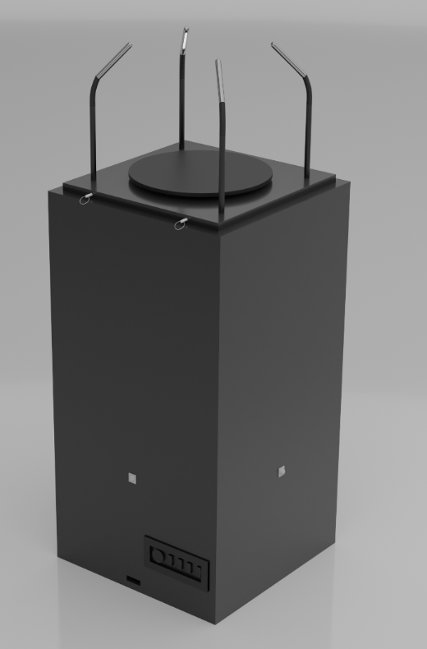
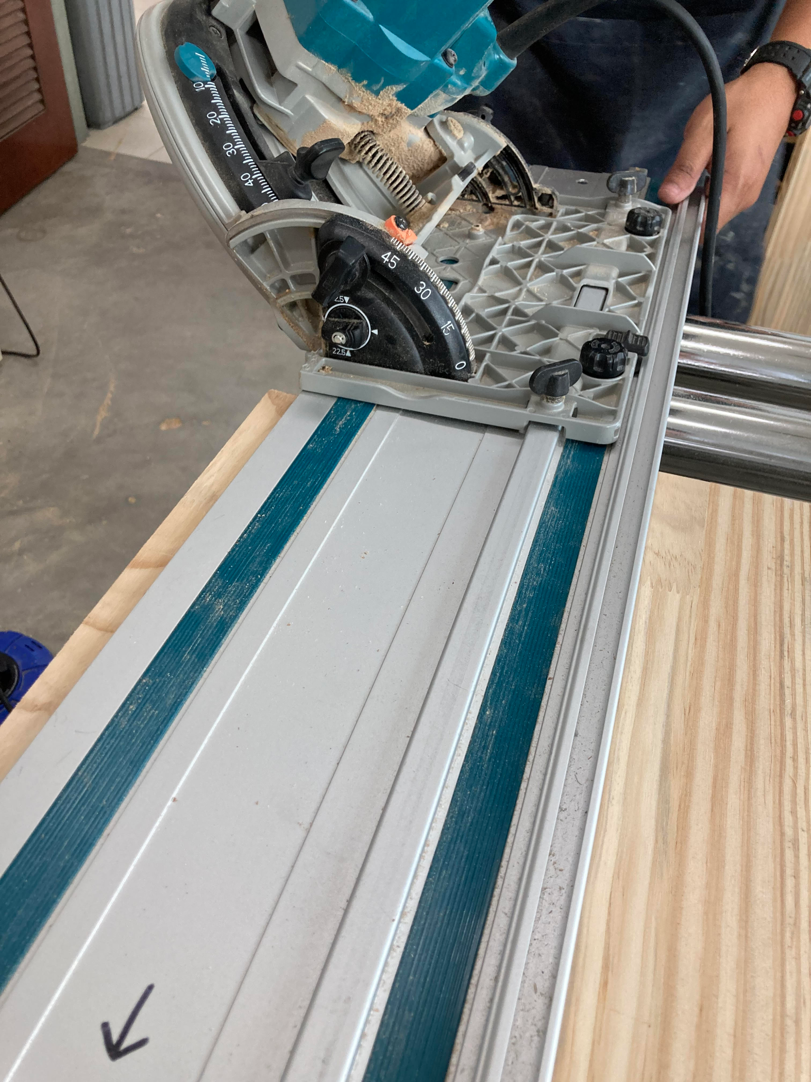
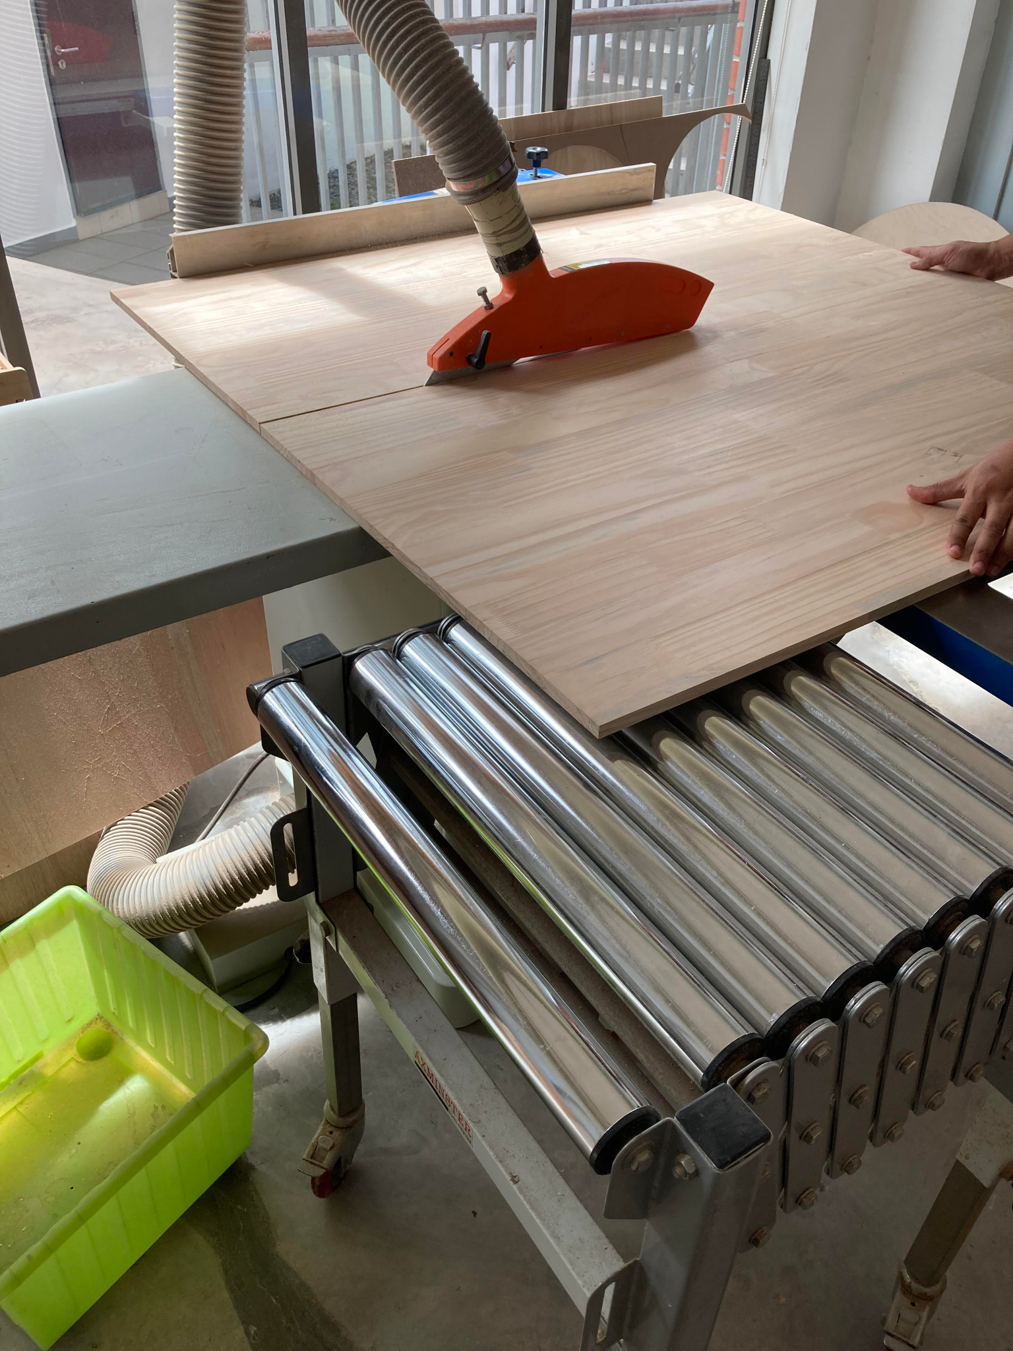
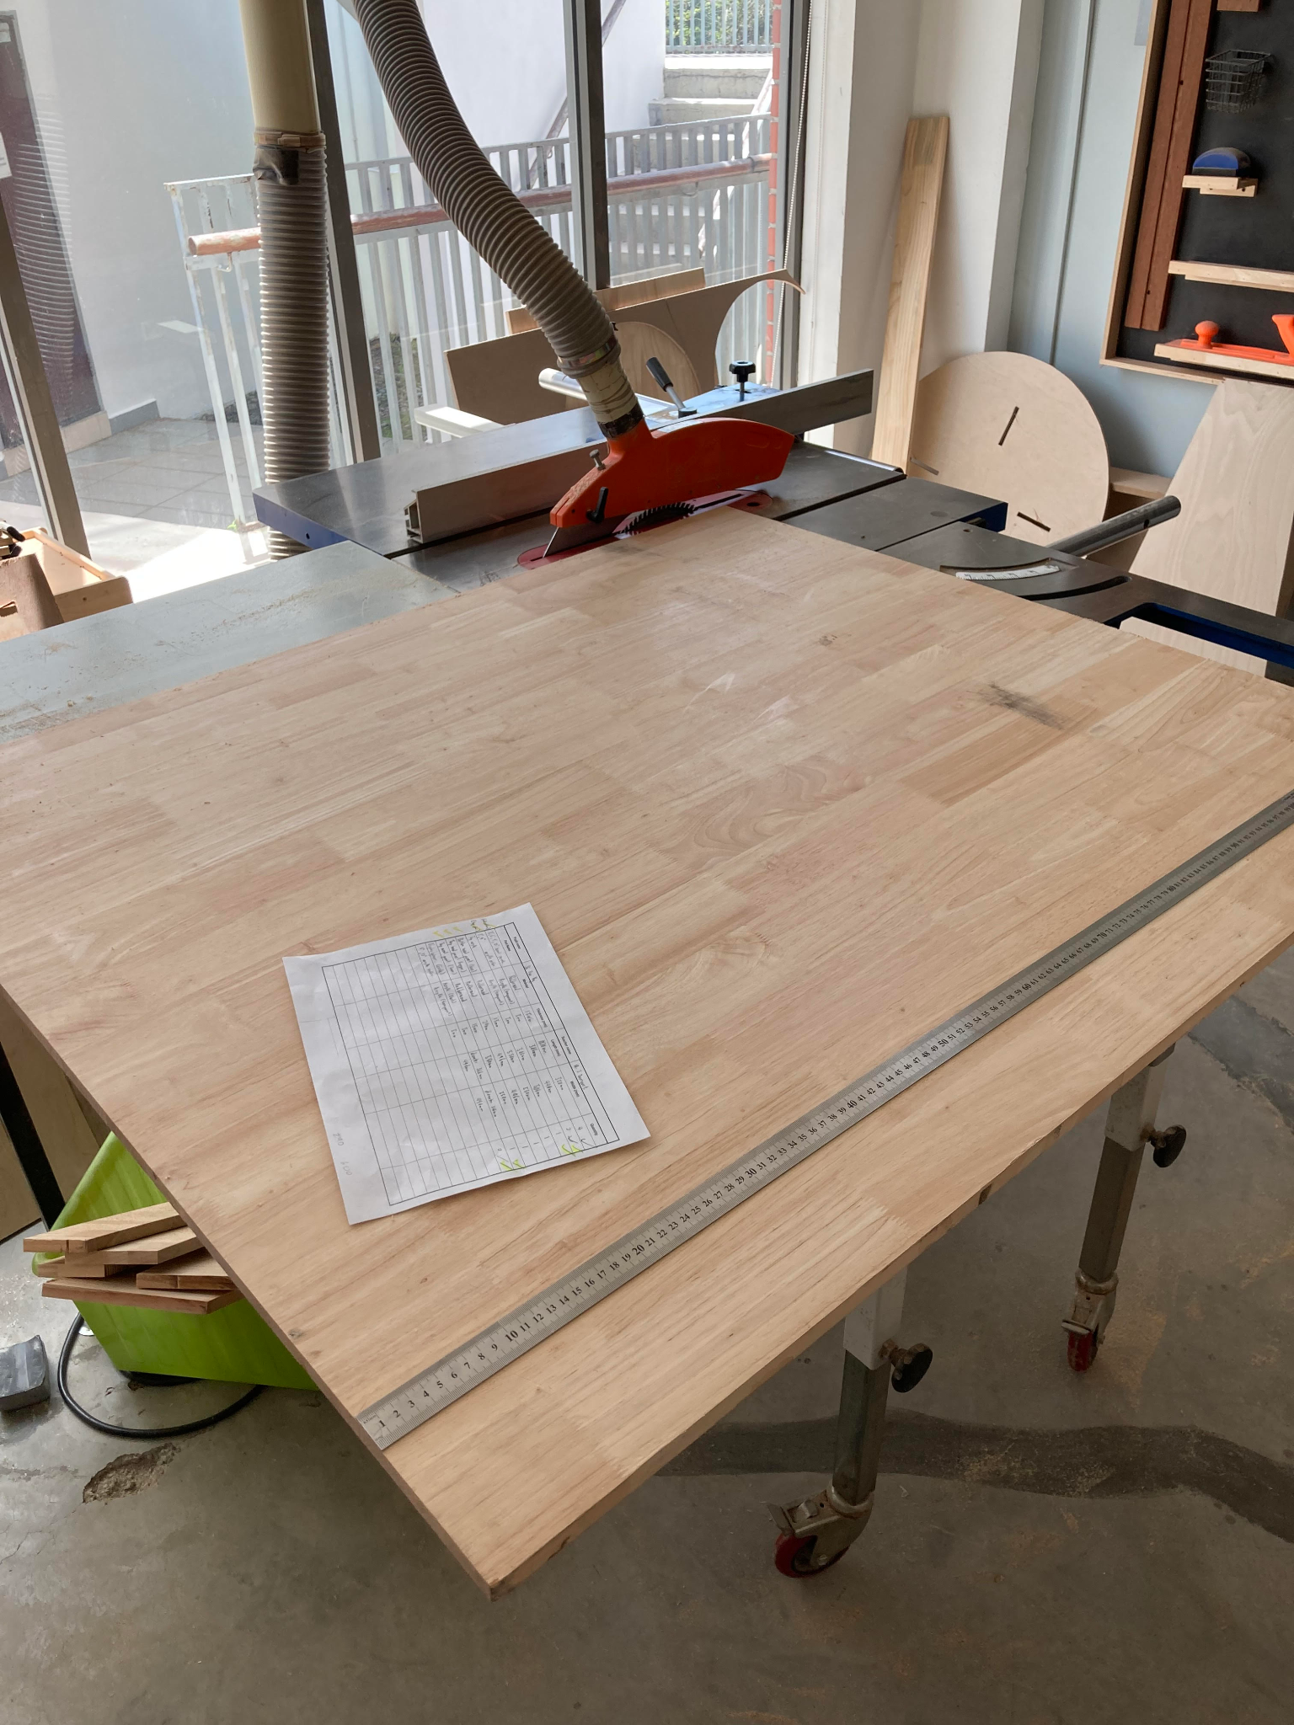
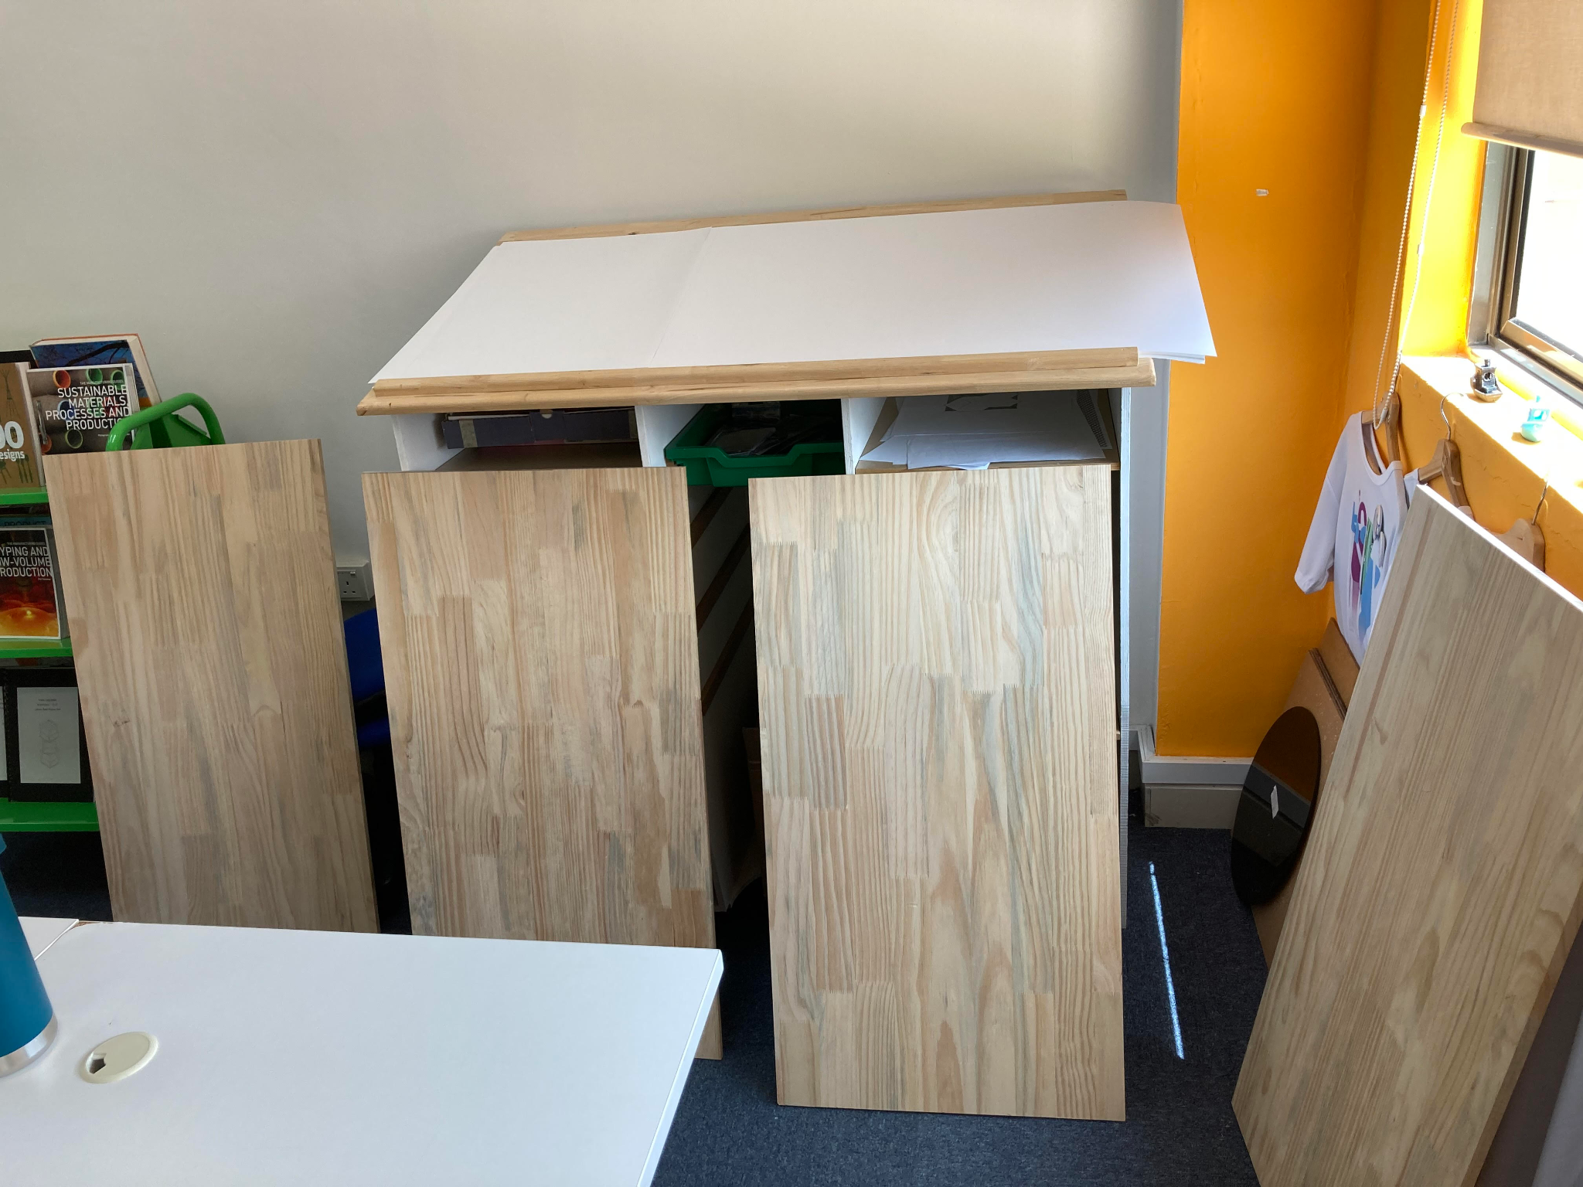
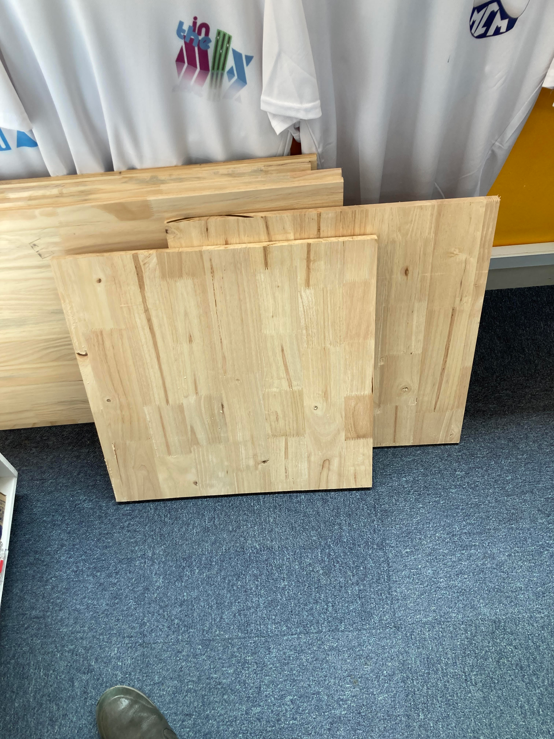
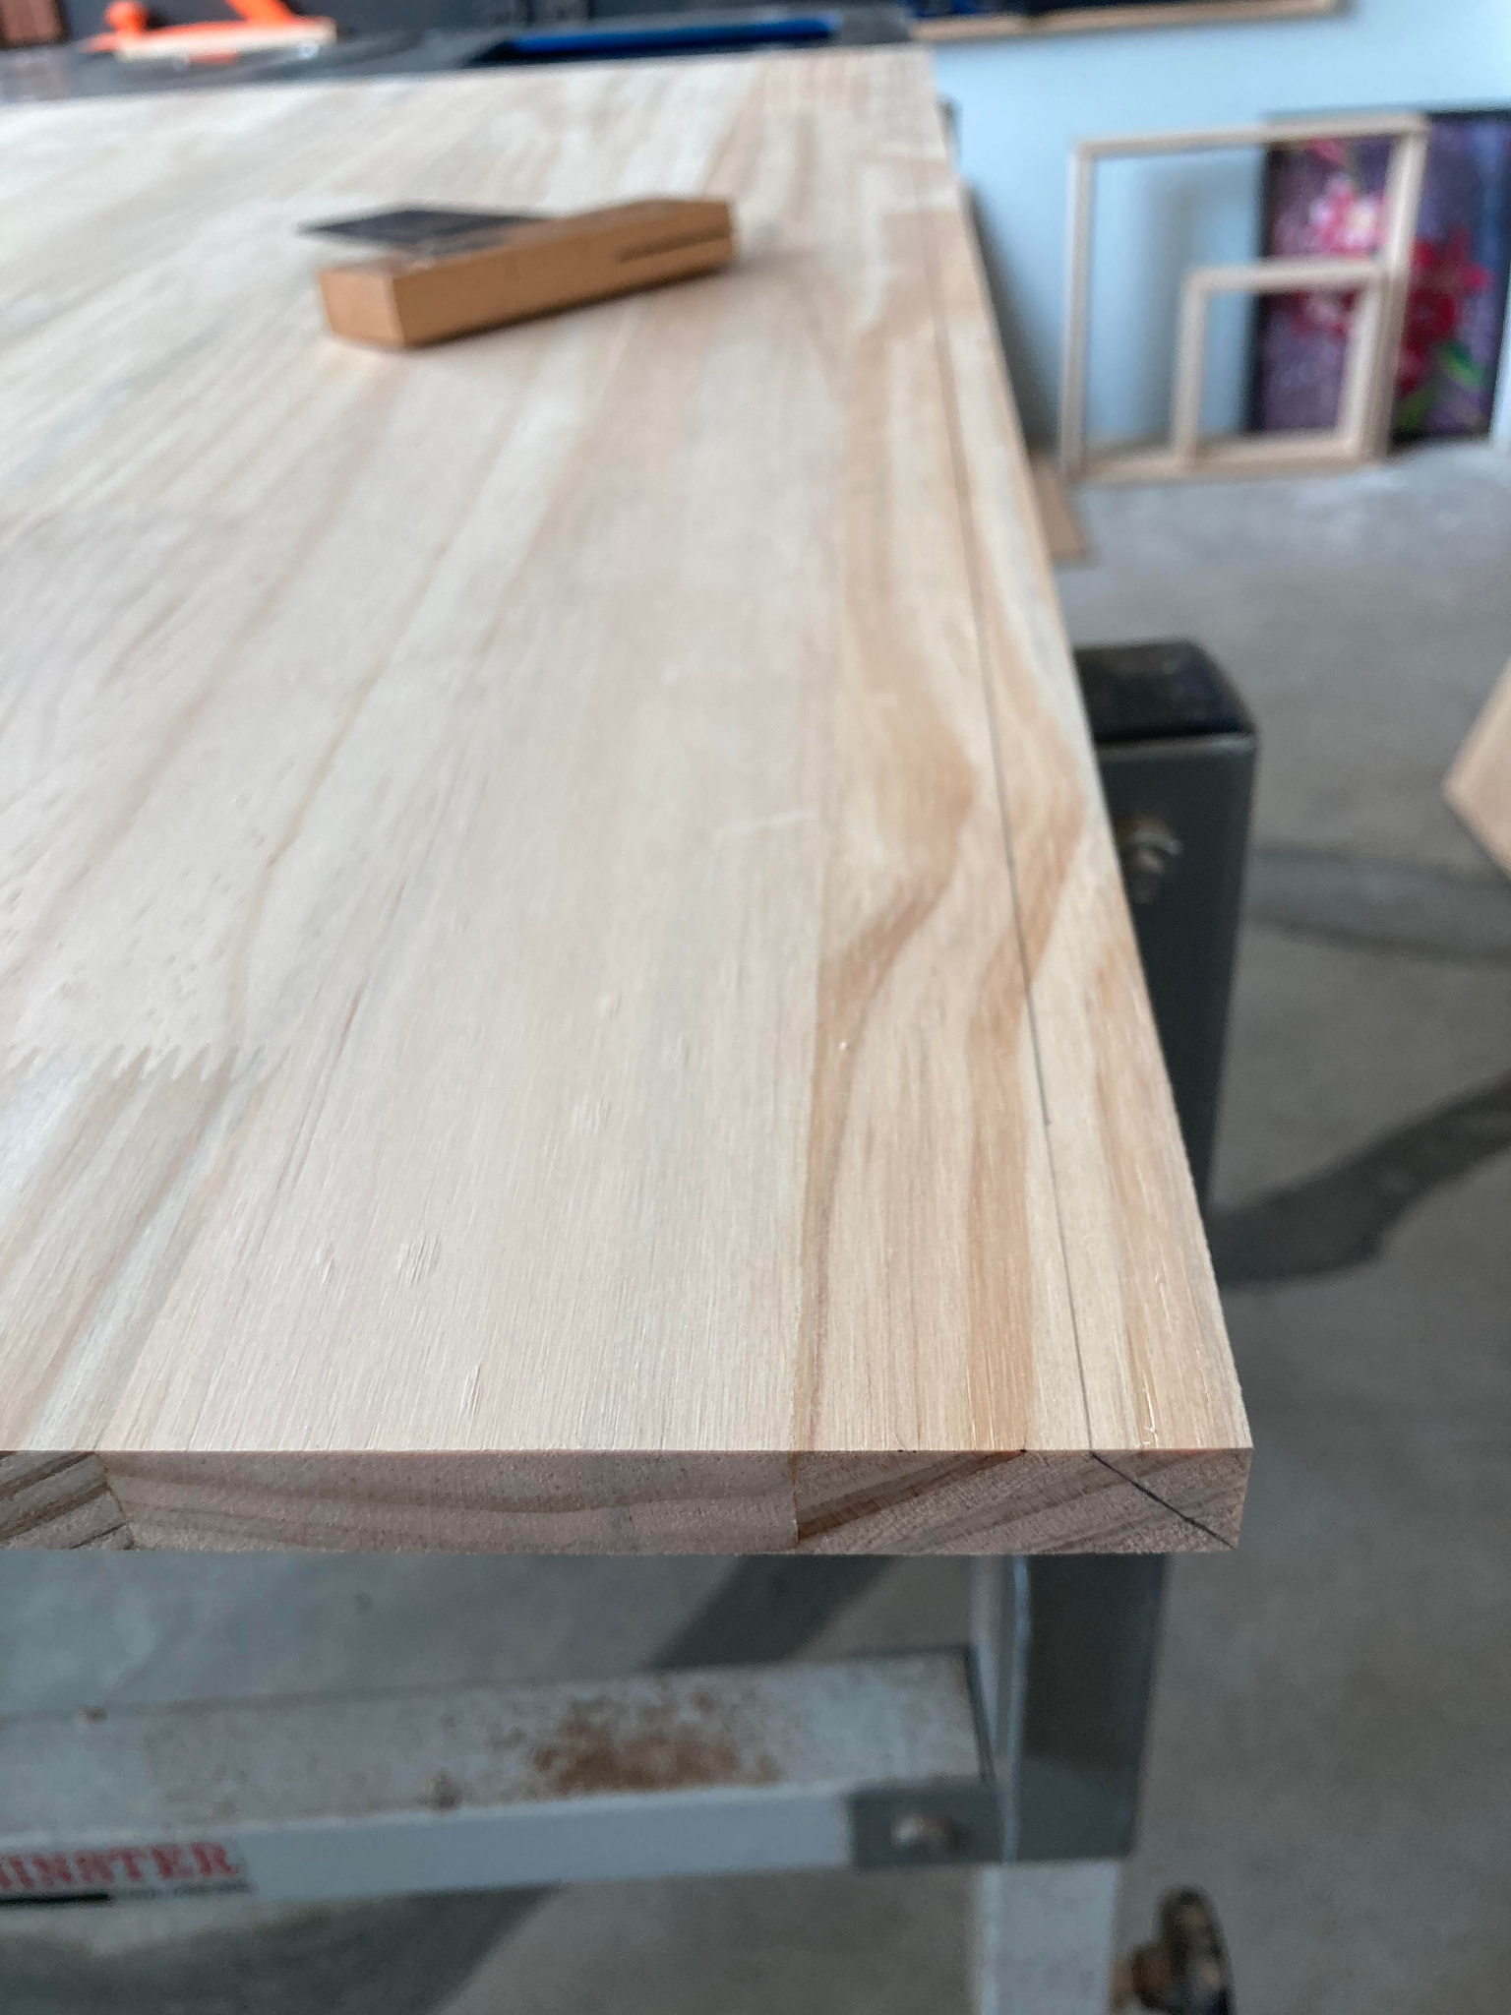
Manufacturing – Cutting out wood panels
Introduction
In this page, I will be cutting out the rubberwood, for all the respective wood panels, as seen in Figure 92.1. In total I need to cut out, based on the orthographic blueprints of the wood panels, ie, figure 92.2 and 92.9:
1x Top wood panel (Top): 496mm x 496mm x 18mm
1x Top wood panel (Bottom): 550mm x 550mm x 18mm
These 2 pieces is needed for the top panel, as seen in the top arrow in figure 92.1, their dimensions are also included in orthographic figure 92.9.
4x Middle wood panel: 1020mm x 550mm x 15mm
These 4 pieces are for the middle of the wood section, as seen in the 2 middle arrows in figure 92.1. Their dimensions are seen in figure 92.2, which they need to have 45 degree edge for mitre joints, and holes cut out after this stage for electronics to fit in them.
1x Bottom wood panel: 550mm x 550mm x 18mm
This piece’s dimensions can be seen from the orthographic of figure 92.10.
Method
For the middle wood panels, I need to use 15 mm rubberwood, which I got a big board from the school’s store room as seen in Figure 92.3. For the middle wood panels, since they will be joint via mitre joint, each edge needs to be 45 degree, as seen in the left diagram in Figure 92.2. Before cutting out the 45 degree edges, I marked out the 45 degree edges as seen in figure 92.6.
To achieve the 45 degree edge, I used a bench saw and track, adjusted to 45 degree, as seen in figure 92.4. To cut out 2 mitre joints for all 4 middle wood panels, I have asked the help of the DT assistant to hold the track of the track saw, whilst I push the track saw ahead. For the straight edges of middle wood panel, top and bottom wood panels, I have used the table saw to cut them out with the help of the DT assistant, as I am not qualified to use the table saw due to safety reasons after marking out.
Figure 92.1
Figure 92.4
Figure 92.5
Figure 92.3
Figure 92.7
Figure 92.8
The result of cutting out can be seen in figure 92.7 and figure 92.8, which figure 92.7 consists of the 4 middle wood panels and their 45 degree edges cutted out. And figure 92.8 shows the bottom and top panels cut out to the correct dimensions.
Figure 92.6
Notes:
https://www.youtube.com/watch?v=OW-Bf3yjUyE
https://www.alibaba.com/product-detail/BringSmart-5M120GN-C-120W-single-phase_62353923070.html?spm=a2700.pccps_detail.normal_offer.d_image.26fb6aa3uB540c
https://www.alibaba.com/product-detail/BringSmart-A5882-45-12v-24v-11_1600214680276.html?spm=a2700.wholesale.0.0.76d97cd8dPe4dk
https://www.lazada.com.my/products/low-speed-high-torque-dc-geared-motor-12v-24v-reversible-and-adjustable-speed-5-to-400rpm-all-metal-gears-long-life-35w-dc-motor-i3186635020-s16150113358.html?

Slide 21
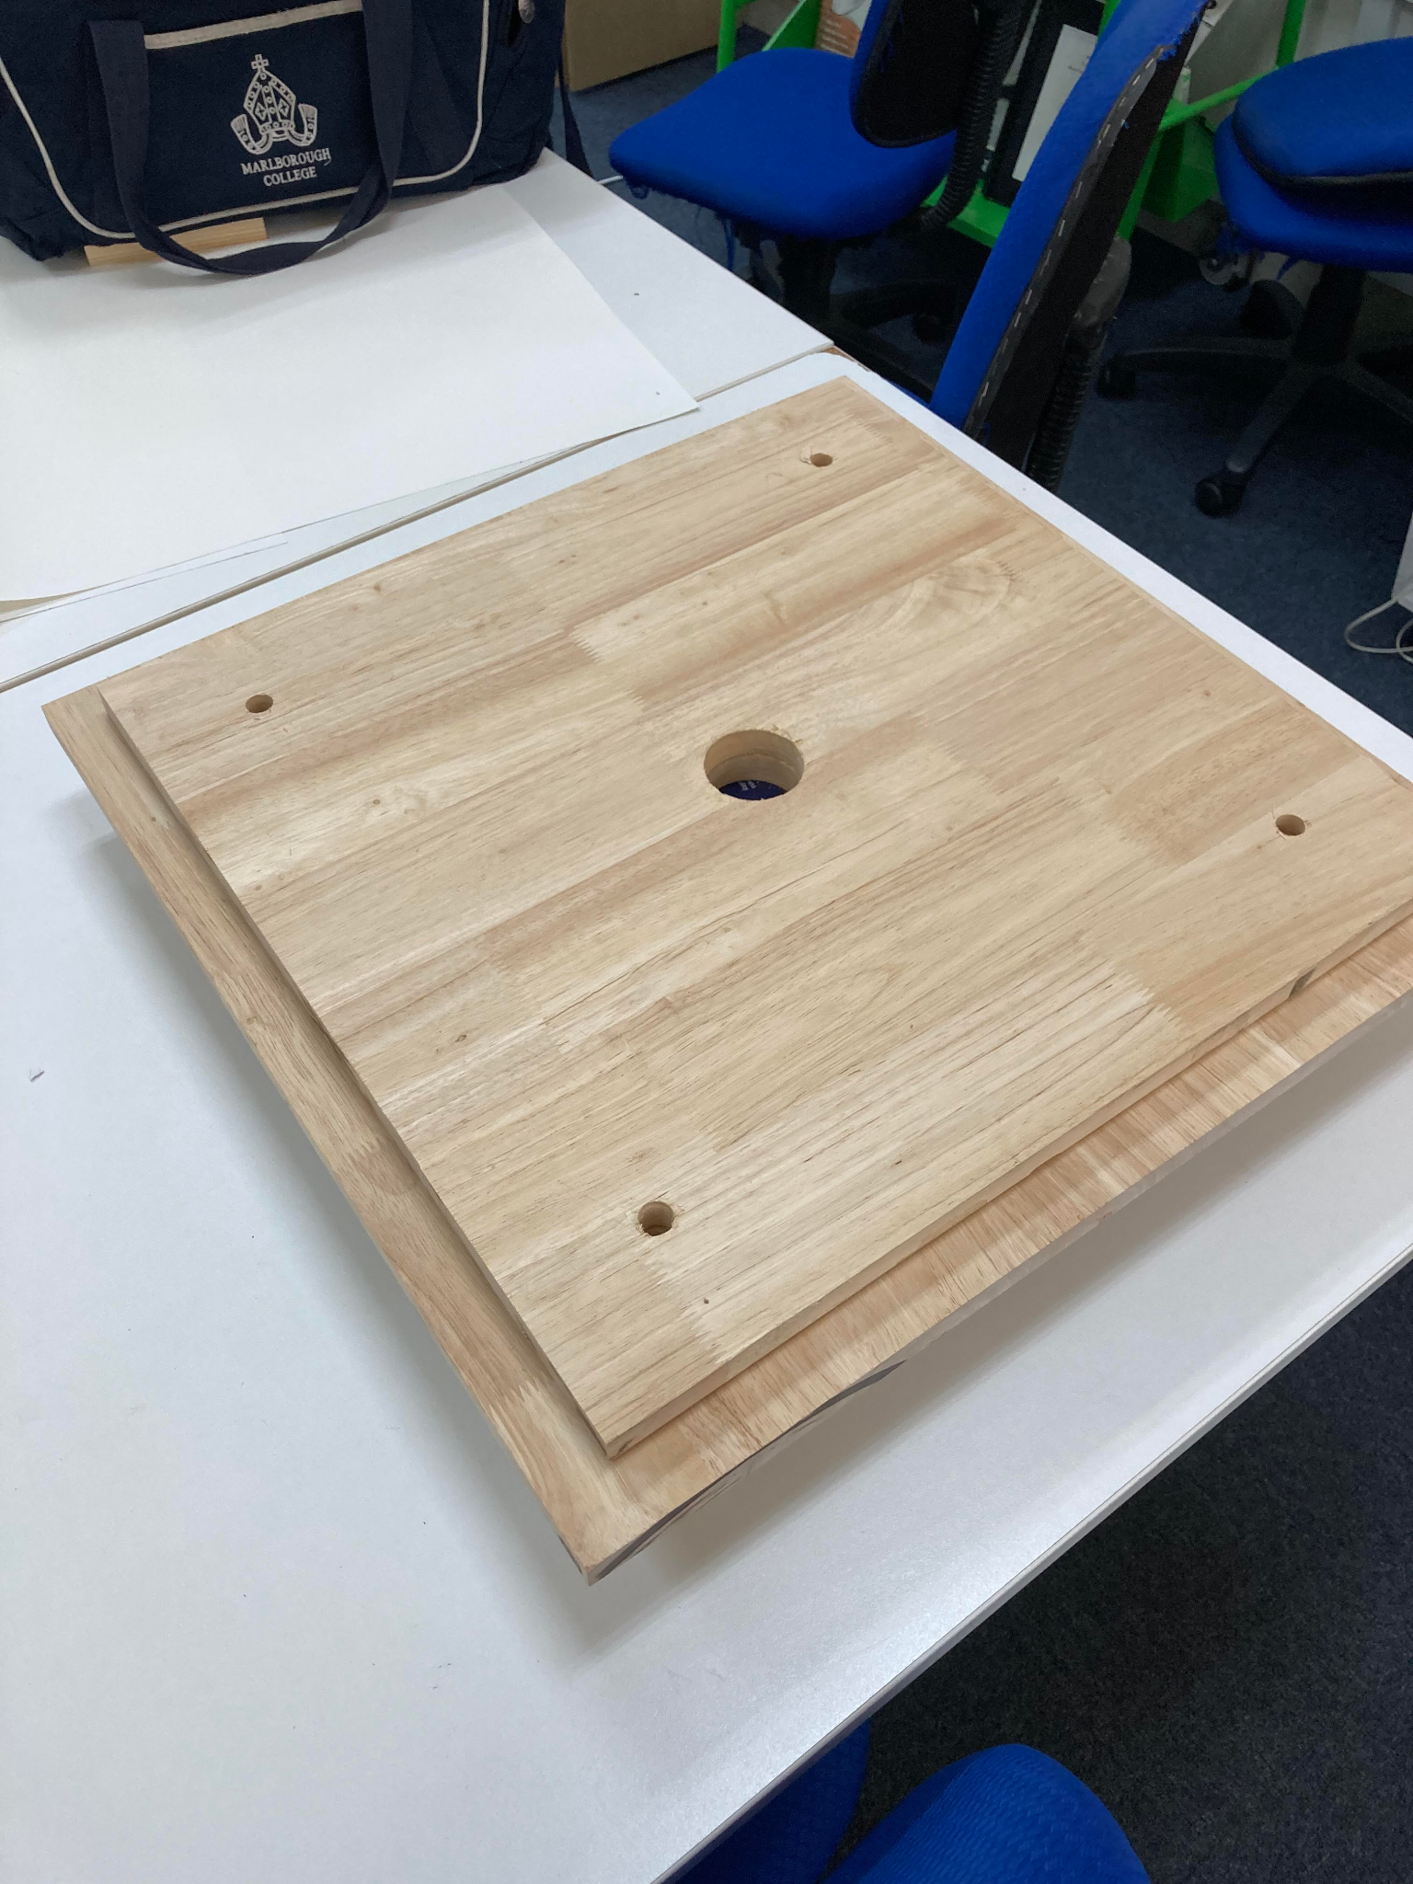
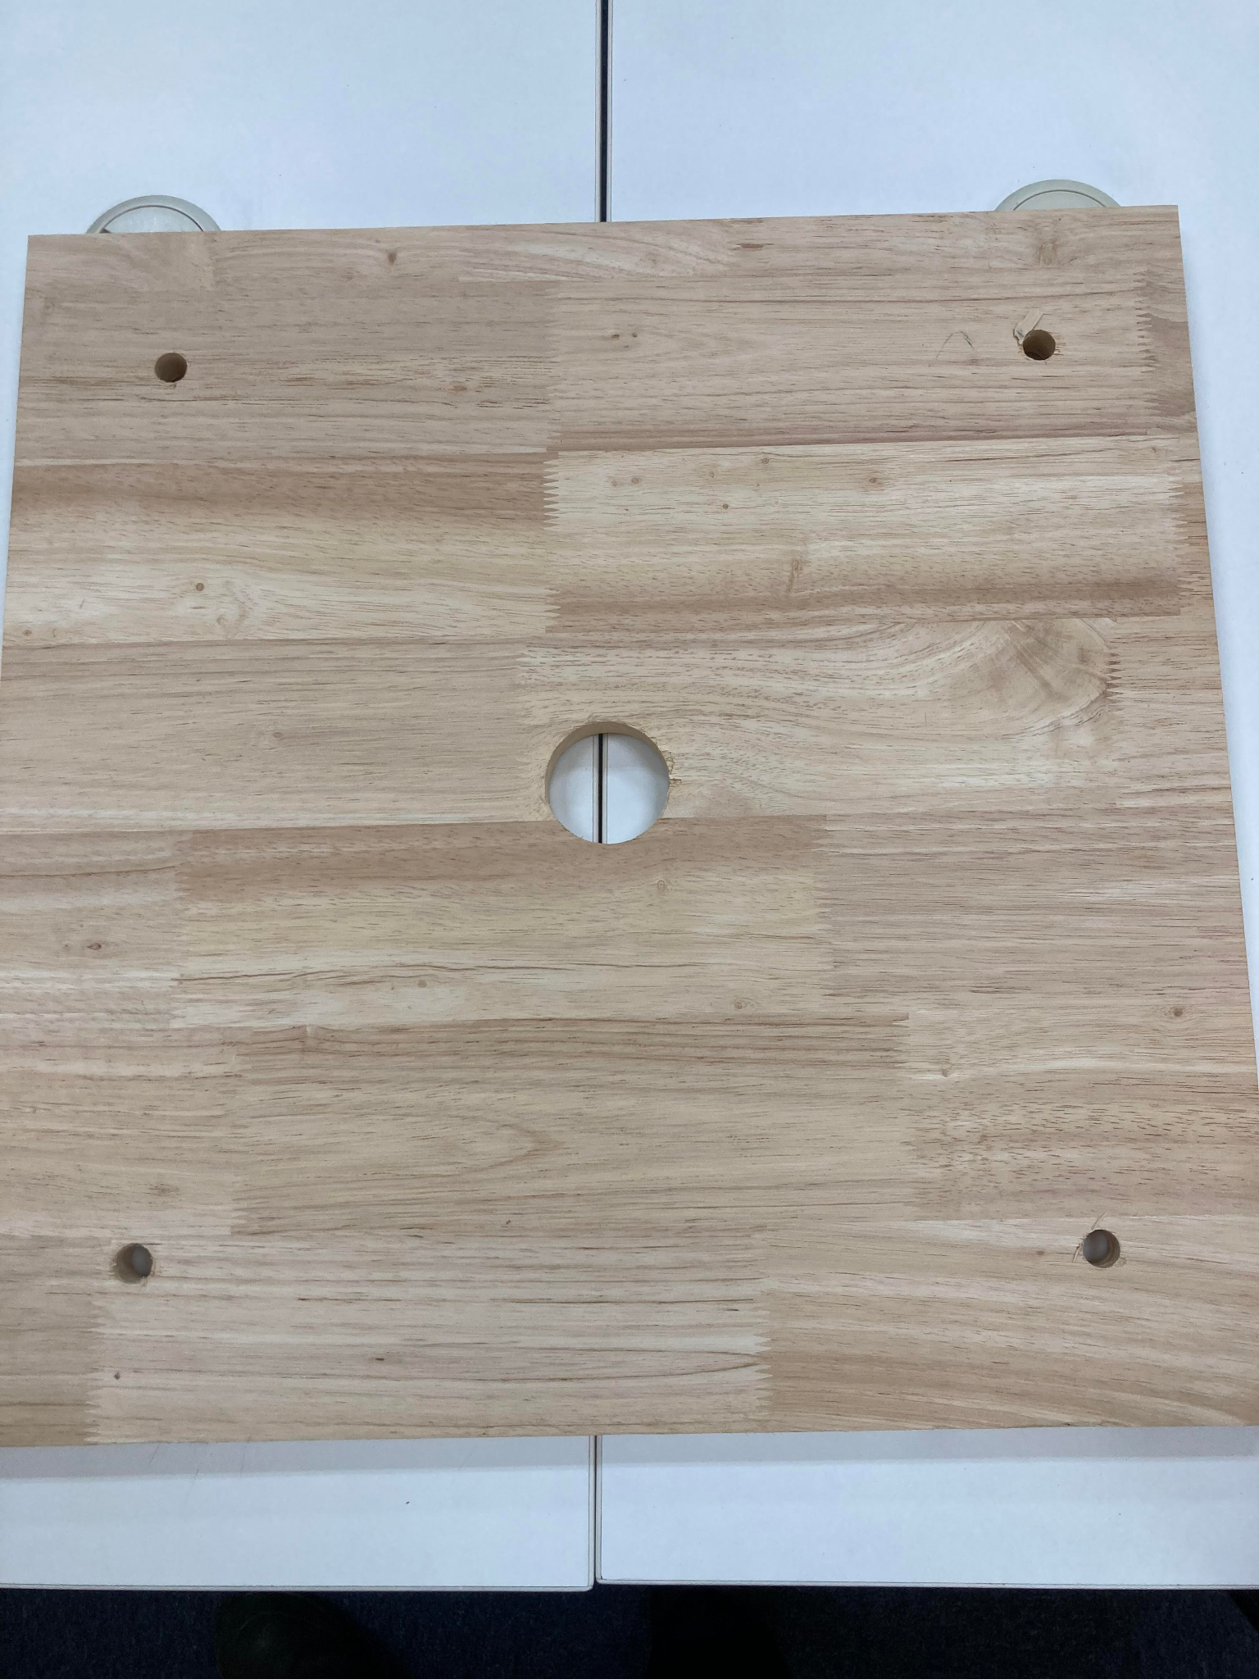
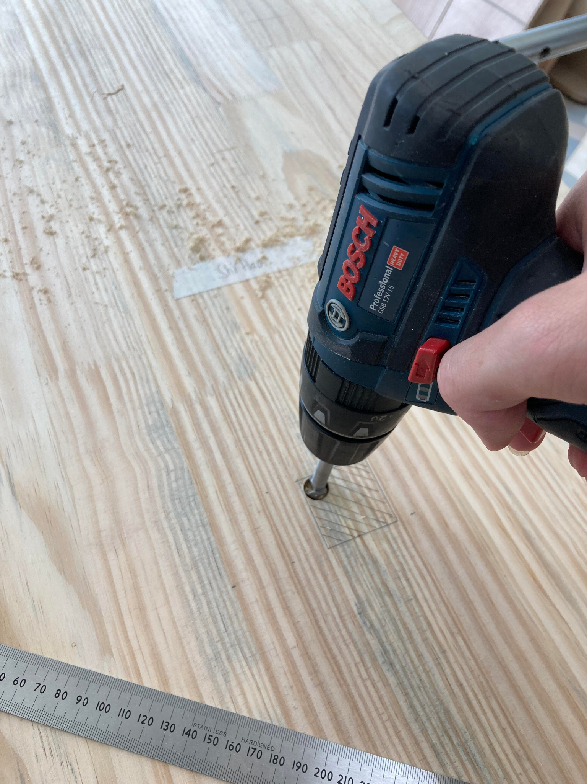
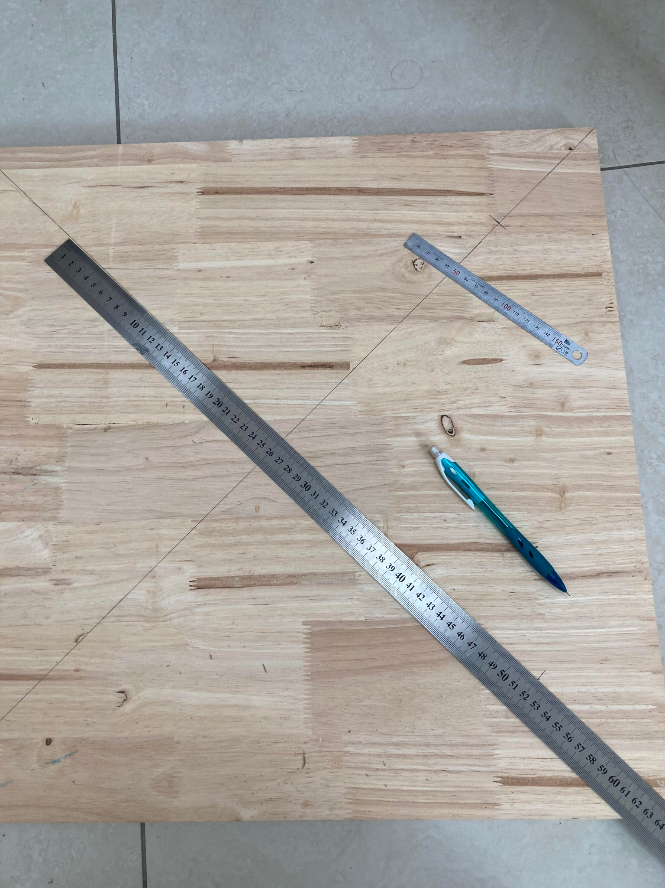
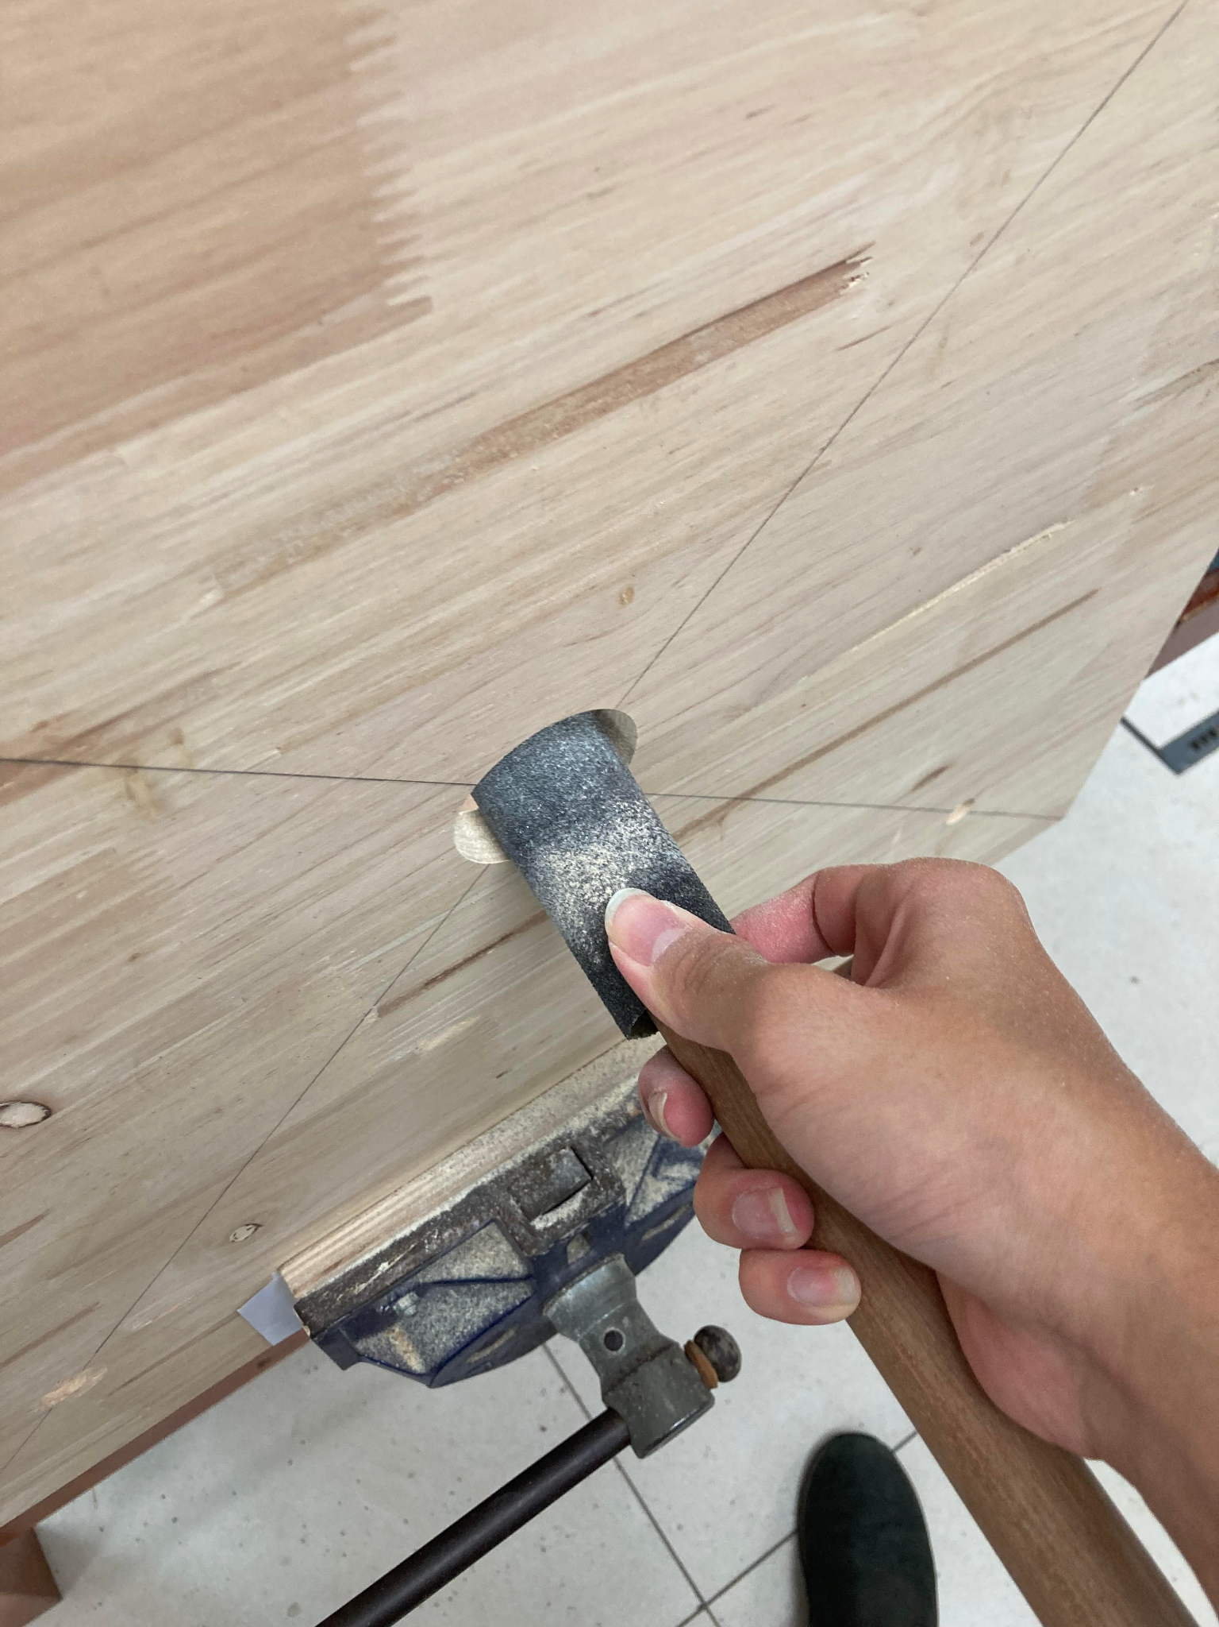
Manufacturing – Cutting out holes on top wood panels
Introduction
After the 2 top wood panels have been cut out, which these 2 top wood panel, the 496 x 496 mm and 550 x 550 mm panels. These 2 panels needs to have 4 respective ø 15 mm holes drilled in, 85 mm away from each of their corner, as seen in Orthographic figure 93.2. These 4 corner holes will then gradually have the 4x iKEA harte lamps sliding through them, as seen in Figure 93.1. A ø 50 mm hole also needs to be cut out in the center of the 2 top wood panels, as seen in Figure 93.2, this ø 50 mm hole will have the display spinner running through it.
Method
To do this, for both pieces of wood panels, I need to accurately mark out where I will be drilling into the 2 respective wood panels. Which as seen in figure 93.6, I marked out both wood panels, and also using pythagoras, as I want the corner holes being 6√2 away from corner for the 496x496 wood panel. Whilst 33√2 away from corner for each of the corner holes for the 550x550 wood panel.
I drilled the holes out using a forstner drill bit attached to a drill driver as seen in Figure 93.5 (picture of me drilling using a drill driver and ø 10 mm forstner drill bit for a different piece, as I have lost the pictures of me drilling for the top panels, apologies). Each of the corner holes are drilled using ø 15 mm forstner drill bits, in order to fit the iKEA lamps which are ø 14 mm in diameter.
Then, once the corner holes for both pieces are drilled out, I then drilled out the center ø 50 mm hole for both top wood panels. A ø 50 mm drill bit is then used with a drill driver. After all the holes are drilled out on both the 496x496 and 550x550 piece, as seen in Figure 93.3 and 93.4. I then sanded down the holes, as seen in figure 93.7, to ensure that all the holes are smooth, and especially for the center hole, as the motor flange will be running through it, friction wouldn’t be great for the display spinner. To sand, I tighten the wood panels onto a woodworking vice as seen in Figure 96.6. And sanded using a 80-grit sandpaper wrapped around a wooden dowel, for ease of sanding a round surface.
Figure 93.1
Figure 93.3
Figure 93.4
Figure 93.5
Figure 93.6
Figure 93.7

